Slide 1
Statistics
Parameswari Ettiappan

Slide 2
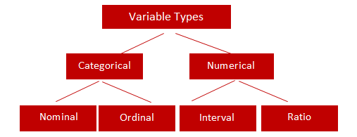
Types of Variables

Slide 3
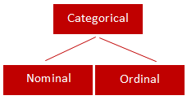
Categorical
Qualitative data are often termed categorical data.
Data that can be added into categories according to their characteristics.
Examples are gender, social class and blood types

Slide 4
Nominal Variable (Unordered list)
A variable that has two or more categories, without any implied ordering.
Examples : Gender - Male, Female
Marital Status - Unmarried, Married, Divorcee
State - New Delhi, Haryana, Illinois, Michigan

Slide 5
Ordinal Variable (Ordered list)
A variable that has two or more categories, with clear ordering. Examples :
Scale - Strongly Disagree, Disagree, Neutral, Agree, Strongly Agree
Rating - Very low, Low, Medium, Great, Very great

Slide 6
Interval
An interval variable is similar to an ordinal variable, except that the intervals between the values of the interval variable are equally spaced.
In other words, it has order and equal intervals.
Examples :
Temperature in Celsius - Temperature of 30°C is higher than 20°C, and temperature of 20°C is higher than 10°C. The size of these intervals is the same.
Annual Income in Dollars - Three people who make $5,000, $10,000 and $15,000. The second person makes $5,000 more than the first person and $5,000 less than the third person, and the size of these intervals is the same.

Slide 7
Ratio
It is interval data with a natural zero point.
When the variable equals 0.0, there is none of that variable. Examples :
Height
Weight
Temperature in Kelvin - It is a ratio variable, as 0.0 Kelvin really does mean 'no temperature.

Slide 8
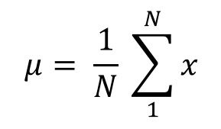
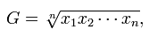
Central Location
(a) Arithmetic Mean
Of these “averages,” the most common and familiar is the arithmetic mean, defined by
(b) Geometric Mean
The geometric mean is defined as the nth root of the product of n observations:

Slide 9
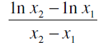
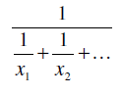
Central Location
© Logarithmic Mean
The logarithmic mean of two numbers is given by the difference of the natural logarithms of the two numbers, divided by the difference between the numbers.
It is used particularly in heat transfer and mass transfer.
(d) Harmonic Mean
The harmonic mean involves inverses—i.e., one divided by each of the quantities.
The harmonic mean is the inverse of the arithmetic mean of all the inverses.

Slide 10
Median
If all the items with which we are concerned are sorted in order of increasing magnitude (size), from the smallest to the largest, then the median is the middle item.
Consider the five items: 12, 13, 21, 27, 31. Then 21 is the median.
If the number of items is even, the median is given by the arithmetic mean of the two middle items. Consider the six items: 12, 13, 21, 27, 31, 33.
The median is (21 + 27) / 2 = 24.

Slide 11
Mode
If the frequency varies from one item to another, the mode is the value which appears most frequently.
In the case of continuous variables the frequency depends upon how many digits are quoted, so the mode is more usefully considered as the midpoint of the class with the largest frequency.

Slide 12
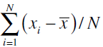
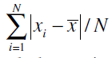
Variability or Spread of the Data
Mean Deviation from the Mean
The mean deviation from the mean, defined as –
Mean Absolute Deviation from the Mean

Slide 13
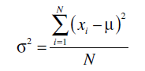
Variability or Spread of the Data
Variance
Since squares of both positive and negative real numbers are always positive, the variance is always positive.

Slide 14
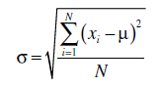
Variability or Spread of the Data
Standard Deviation

Slide 15
Quartiles, Deciles, Percentiles, and Quantiles
Quartiles, deciles, and percentiles divide a frequency distribution into a number of parts containing equal frequencies.
Quartiles divide the range of values into four parts, each containing one quarter of the values.
Percentiles divide into a hundred parts, each containing one hundredth of the total frequency.
Quantile divides a frequency distribution into parts containing stated proportions of a distribution.

Slide 16
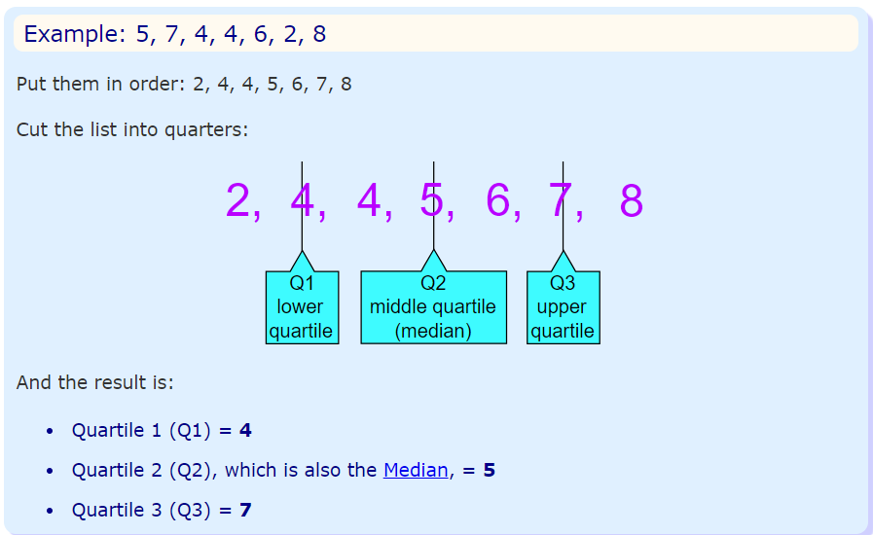
Quartiles
Quartiles are the values that divide a list of numbers into quarters:
Put the list of numbers in order
Then cut the list into four equal parts
The Quartiles are at the "cuts“

Slide 17
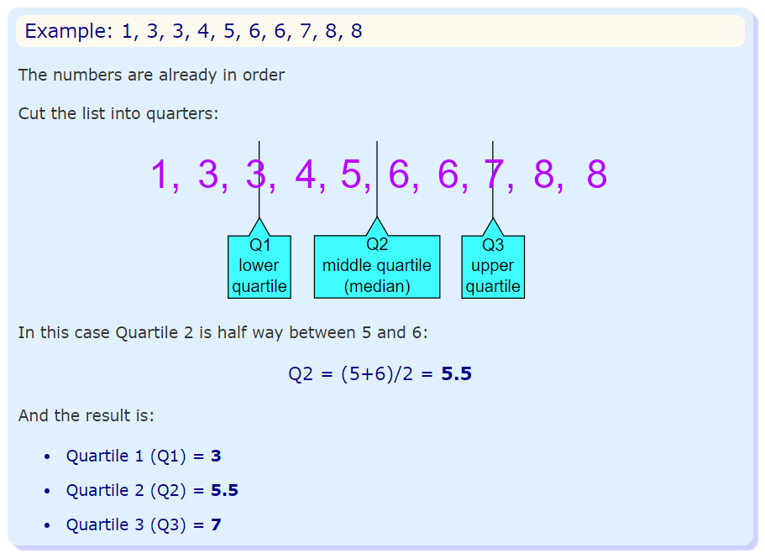
Quartiles

Slide 18
Normal Distribution
A normal distribution, sometimes called the bell curve, is a distribution that occurs naturally in many situations.
For example, the bell curve is seen in tests like the SAT and GRE.
The bulk of students will score the average (C), while smaller numbers of students will score a B or D.
An even smaller percentage of students score an F or an A.
This creates a distribution that resembles a bell (hence the nickname).
The bell curve is symmetrical. Half of the data will fall to the left of the mean; half will fall to the right.

Slide 19
Normal Distribution
Many groups follow this type of pattern. That’s why it’s widely used in business, statistics and in government bodies like the FDA:
Heights of people.
Measurement errors.
Blood pressure.
Points on a test.
IQ scores.
Salaries.

Slide 20
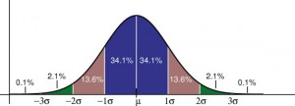
Normal Distribution
The empirical rule tells you what percentage of your data falls within a certain number of standard deviations from the mean: • 68% of the data falls within one standard deviation of the mean. • 95% of the data falls within two standard deviations of the mean. • 99.7% of the data falls within three standard deviations of the mean.

Slide 21
Normal Distribution
The standard deviation controls the spread of the distribution.
A smaller standard deviation indicates that the data is tightly clustered around the mean; the normal distribution will be taller.
A larger standard deviation indicates that the data is spread out around the mean; the normal distribution will be flatter and wider.

Slide 22
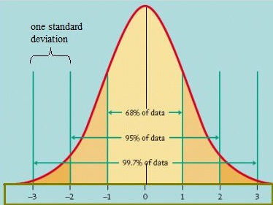
Standard Normal Model

Slide 23
Normal Distribution
Properties of a normal distribution
The mean, mode and median are all equal.
The curve is symmetric at the center (i.e. around the mean, μ).
Exactly half of the values are to the left of center and exactly half the values are to the right.
The total area under the curve is 1.

Slide 24
Word problems with normal distribution: “Between”: Steps
Step 1: Identify the parts of the word problem. The word problem will identify:
The mean (average or μ).
Standard deviation (σ).
Number selected (i.e. “choose one at random” or “select ten at random”).
X: the numbers associated with “between” (i.e. “between $5,000 and $10,000” would have X as 5,000 and as $10,000).

Slide 25
Word problems with normal distribution: “Between”: Steps
Step 1: Identify the parts of the word problem. The word problem will identify:
The mean (average or μ).
Standard deviation (σ).
Number selected (i.e. “choose one at random” or “select ten at random”).
X: the numbers associated with “between” (i.e. “between $5,000 and $10,000” would have X as 5,000 and as $10,000).

Slide 26
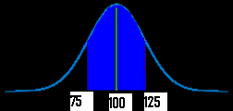
Word problems with normal distribution: “Between”: Steps
Step 2: Draw a graph. Put the mean you identified in Step 1 in the center.
Put the number associated with “between” on the graph (take a guess at where the numbers would fall–it doesn’t have to be exact).
For example, if your mean was $100, and you were asked for “hourly wages between $75 and $125”) your graph will look something like this:

Slide 27
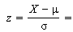
Word problems with normal distribution: “Between”: Steps
Step 3:Figure out the z-scores.
Plug the first X value (in my graph above, it’s 75) into the z value formula and solve. The μ (the mean), is 100 from the sample graph. You can get these figures (including σ, the standard deviation) from your answers in step 1 :
z score formula
*Note: if the formula confuses you, all this formula is asking you to do is:
subtract the mean from X
divide by the standard deviation.

Slide 28
Word problems with normal distribution: “Between”: Steps
Step 4: Repeat step 3 for the second X.
Step 5: Take the numbers from step 3 and 4 and use them to find the area in the z-table.
Step 6a:
Convert the answer from step 5 into a percentage.
For example, 0.1293 is 12.93%.
That’s it–skip step 6b!
Step 6b
Multiply the sample size (found in step 1) by the z-value you found in step 4. For example, 0.300 * 100 = 30.
That’s it!

Slide 29
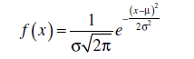
Normal Distribution
They are approximately symmetrical, and the mode is close to the centre of the distribution.
The mean, median, and mode are close together.
The shape of the distribution can be approximated by a bell: nearly flat on top, then decreasing more quickly, then decreasing more slowly toward the tails of the distribution.
This implies that values close to the mean are relatively frequent, and values farther from the mean tend to occur less frequently.
Probability Density Function

Slide 30
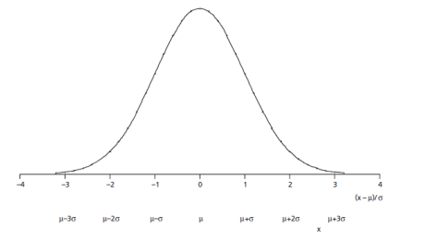
Normal Distribution

Slide 31
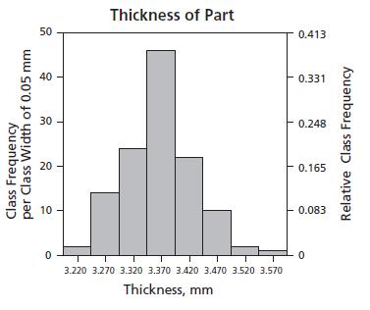
Normal Distribution

Slide 32
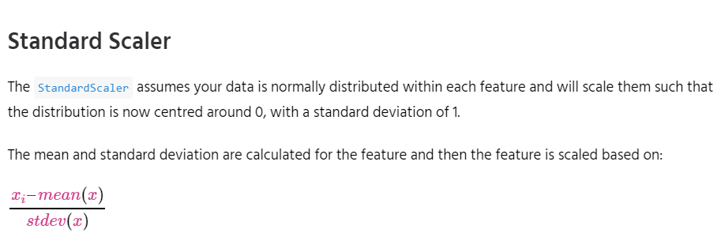
Feature Scaling
StandardScaler
MinMaxScaler
RobustScaler
Normalizer

Slide 33
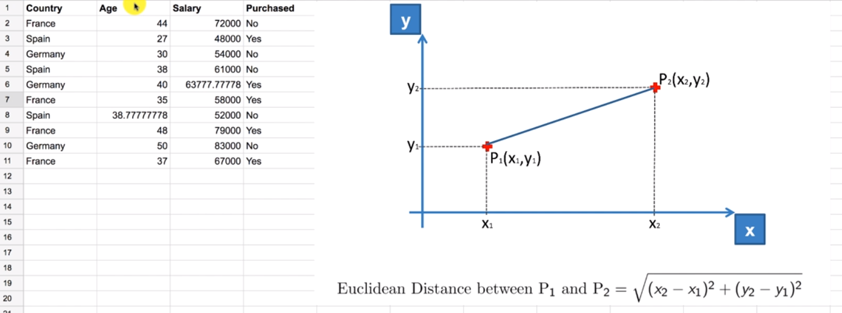

Slide 34
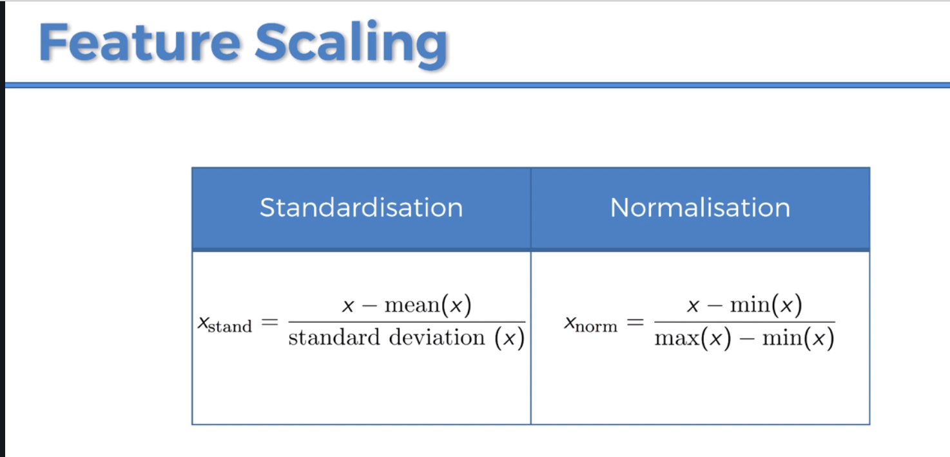

Slide 35
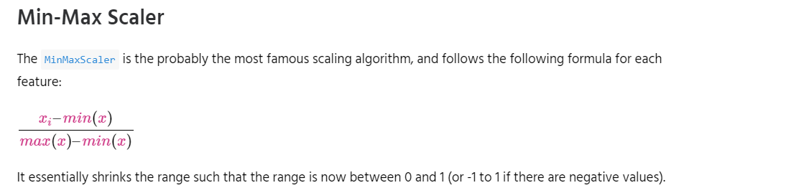
Feature Scaling
StandardScaler
MinMaxScaler
RobustScaler
Normalizer

Slide 36
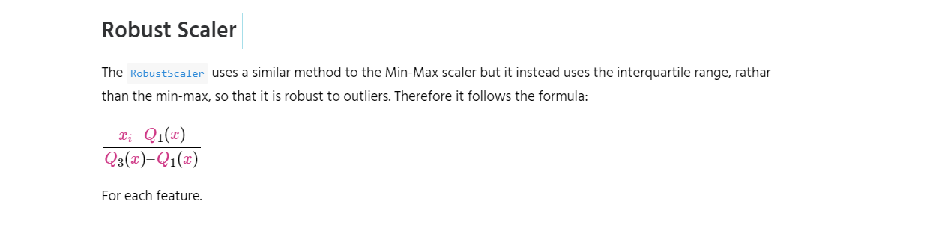
Feature Scaling

Slide 37
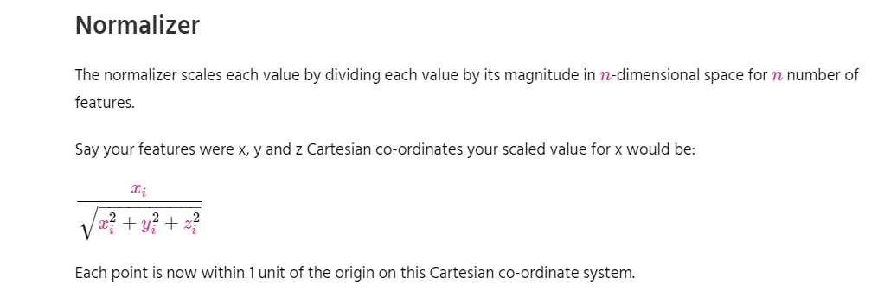
Feature Scaling

Slide 38
Simple Linear Regression
Simple linear regression is a statistical method that allows us to summarize and study relationships between two continuous (quantitative) variables:
One variable, denoted x, is regarded as the predictor, explanatory, or independent variable.
The other variable, denoted y, is regarded as the response, outcome, or dependent variable.

Slide 39
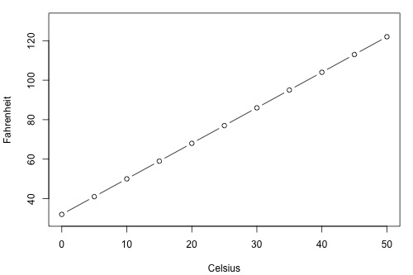
Simple Linear Regression

Slide 40
Types of Relationships
Deterministic
Temperature conversion
Circumference = π × diameter
Hooke's Law: Y = α + βX, where Y = amount of stretch in a spring, and X = applied weight.
Ohm's Law: I = V/r, where V = voltage applied, r = resistance, and I = current.
Boyle's Law: For a constant temperature, P = α/V, where P = pressure, α = constant for each gas, and V = volume of gas.

Slide 41
Types of Relationships
Statistical
Height and weight — as height increases, you'd expect weight to increase, but not perfectly.
Alcohol consumed and blood alcohol content — as alcohol consumption increases, you'd expect one's blood alcohol content to increase, but not perfectly.
Vital lung capacity and pack-years of smoking — as amount of smoking increases (as quantified by the number of pack-years of smoking), you'd expect lung function (as quantified by vital lung capacity) to decrease, but not perfectly.
Driving speed and gas mileage — as driving speed increases, you'd expect gas mileage to decrease, but not perfectly.

Slide 42
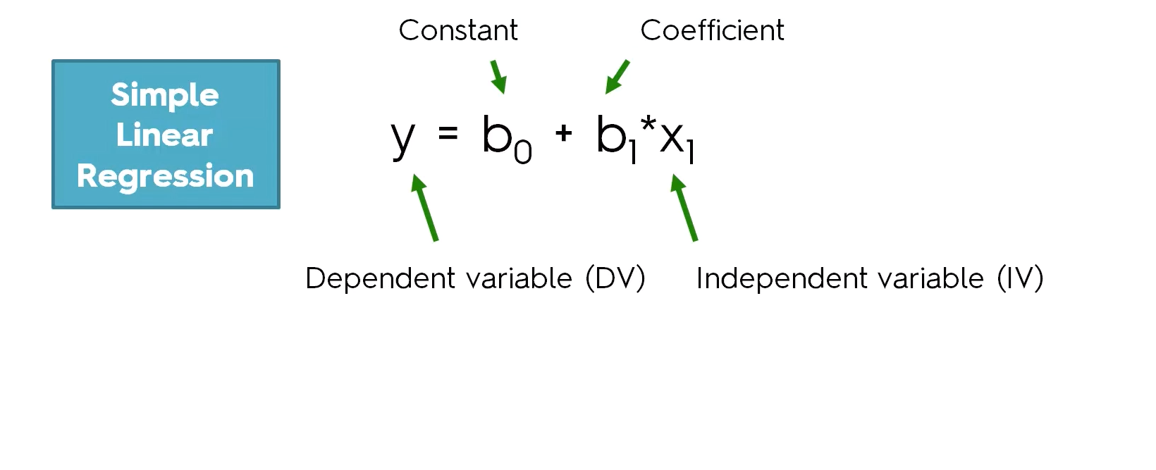

Slide 43
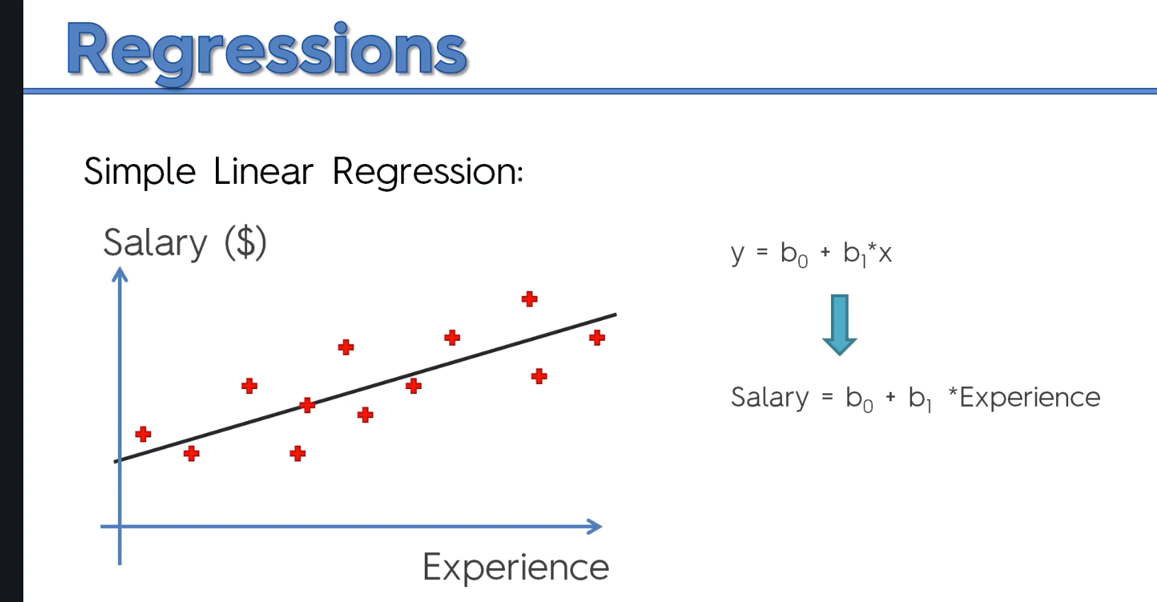

Slide 44
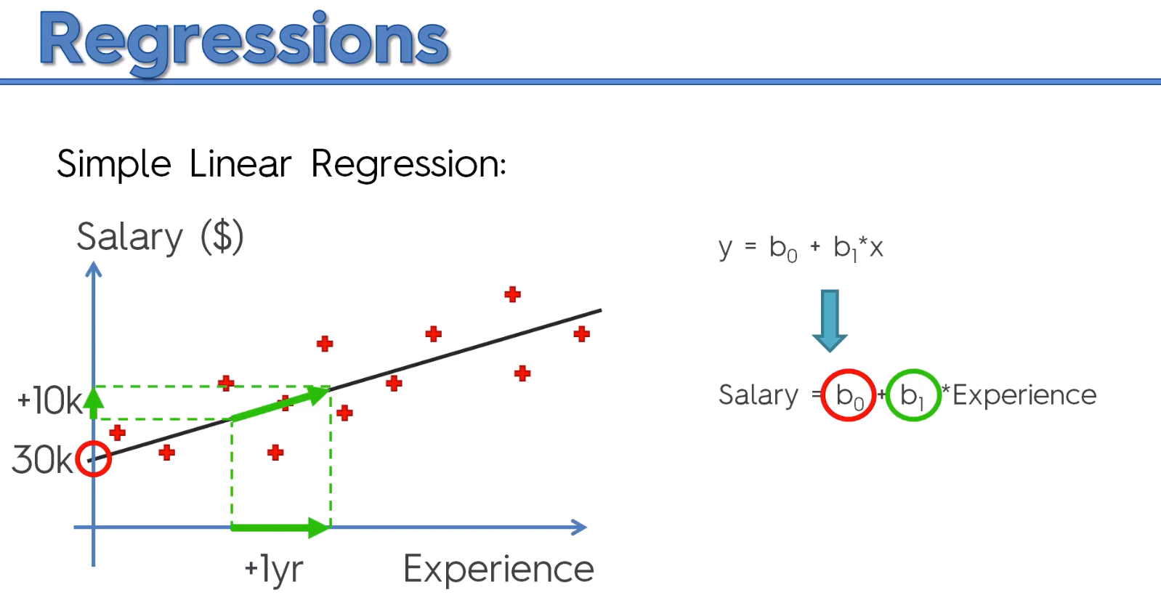

Slide 45
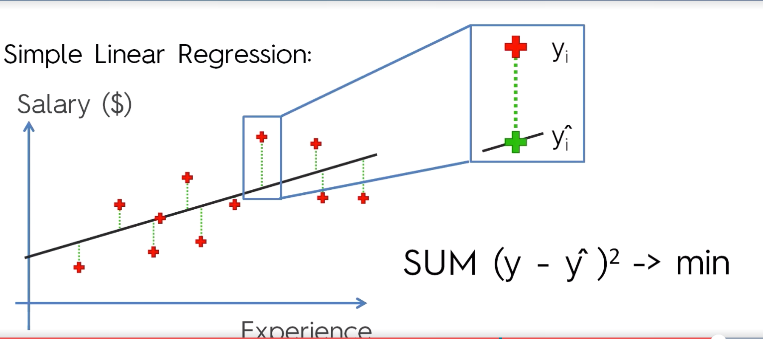
Ordinary Least Square Method

Slide 46
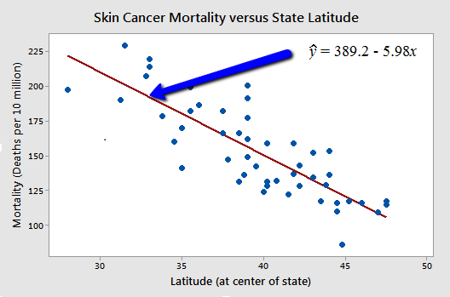
Types of Relationships

Slide 47
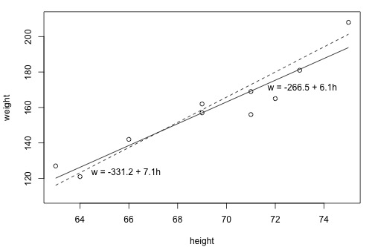
What is the "Best Fitting Line"?

Slide 48
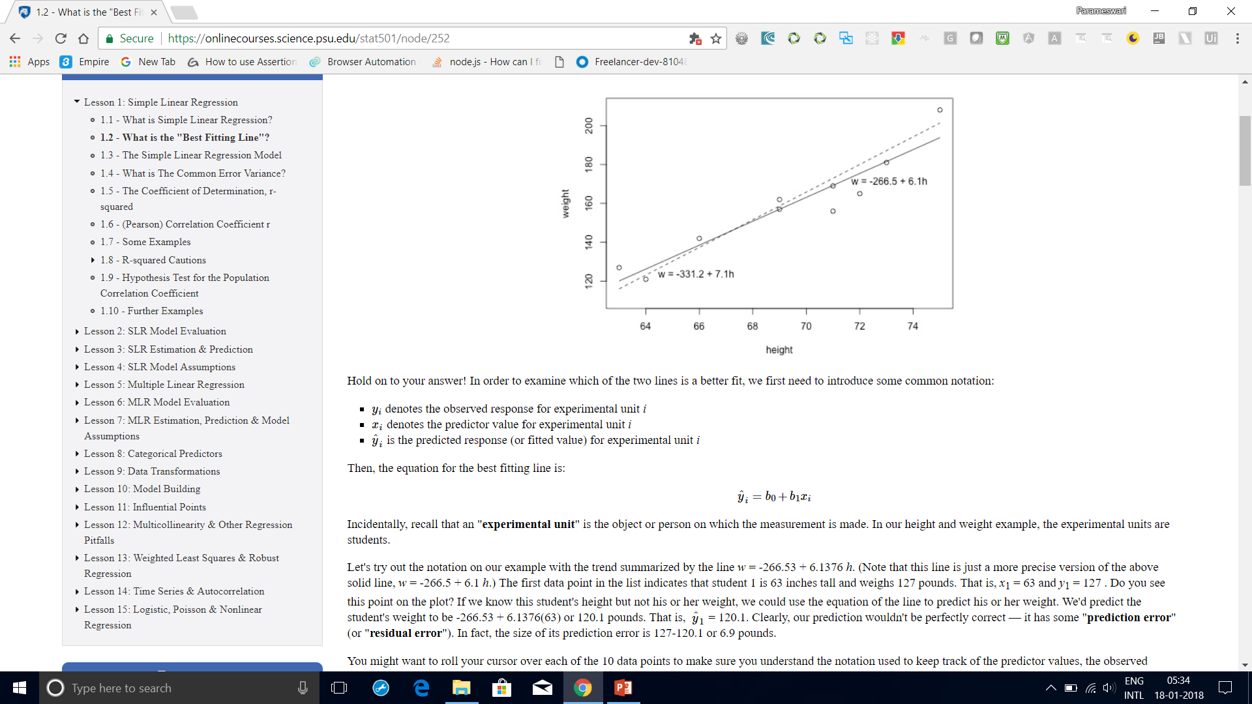
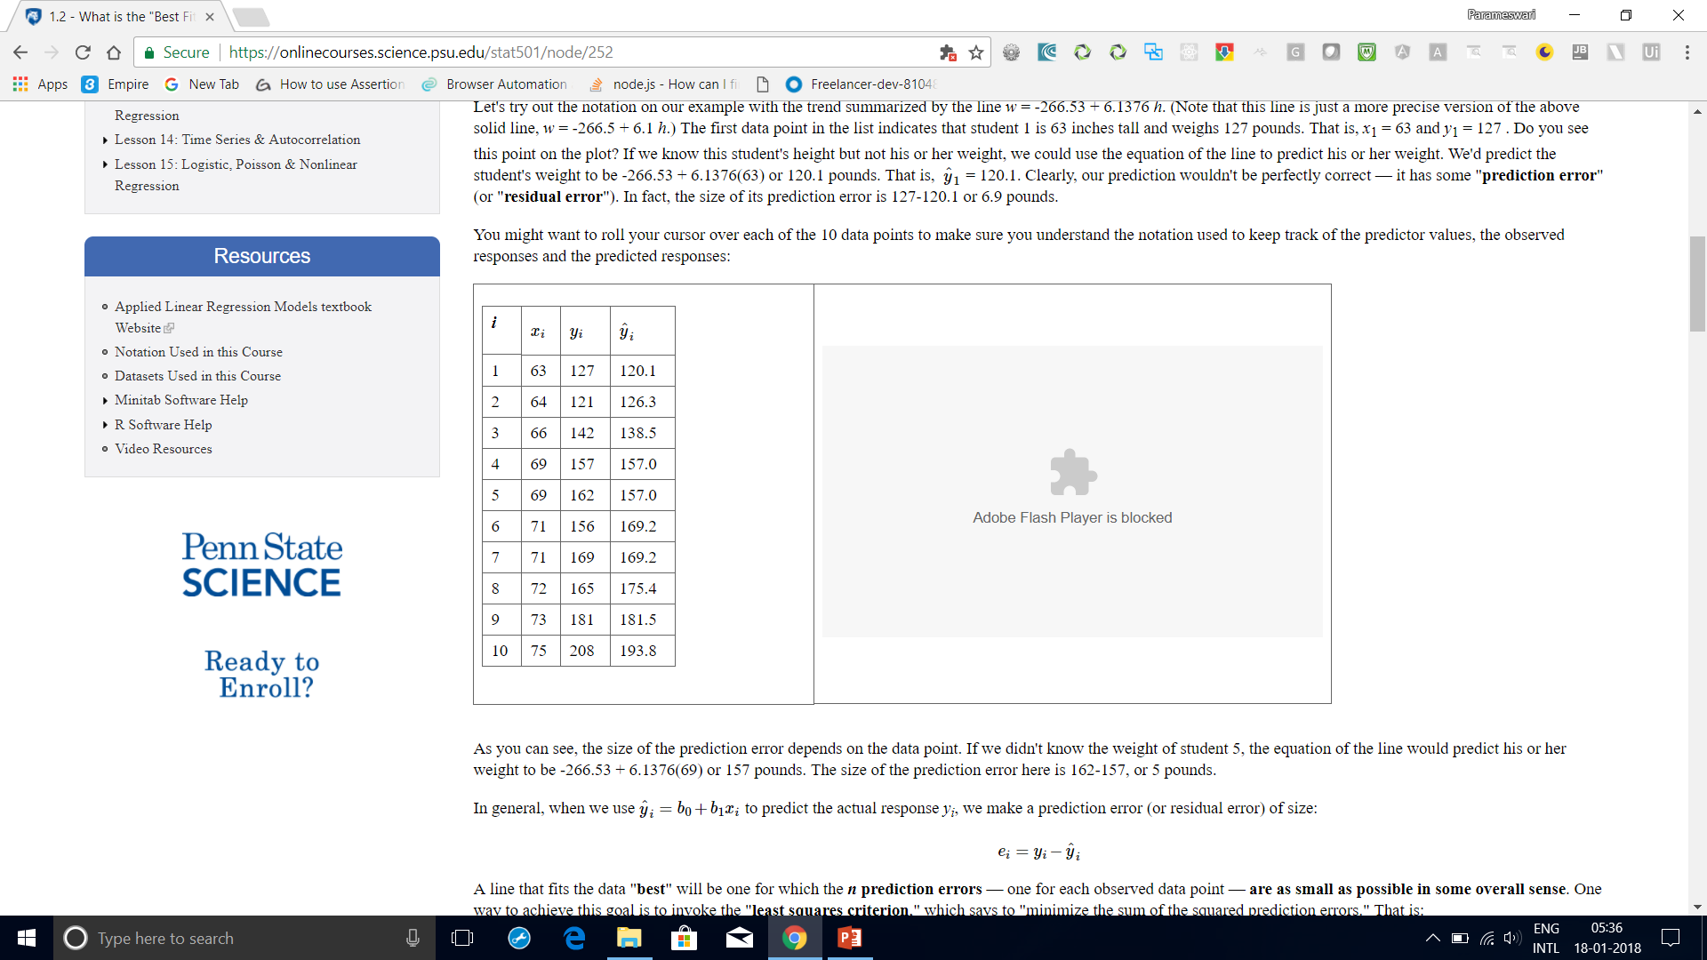
What is the "Best Fitting Line"?
it has some "prediction error" (or "residual error").
In fact, the size of its prediction error is 127-120.1 or 6.9 pounds.
As you can see, the size of the prediction error depends on the data point.
If we didn't know the weight of student 5, the equation of the line would predict his or
her weight to be -266.53 + 6.1376(69) or 157 pounds.
The size of the prediction error here is 162-157, or 5 pounds.

Slide 49
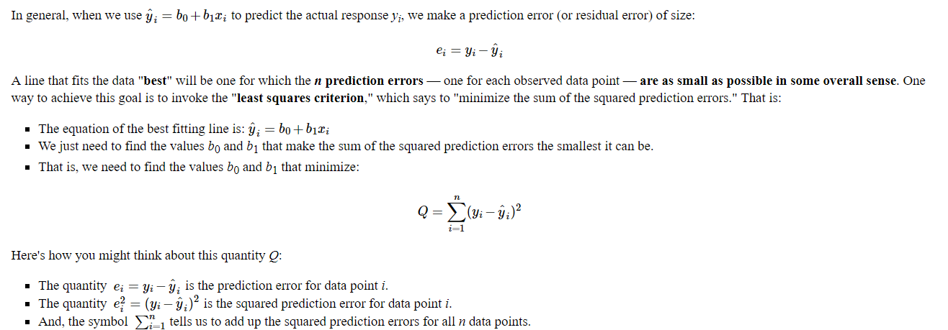
What is the "Best Fitting Line"?

Slide 50
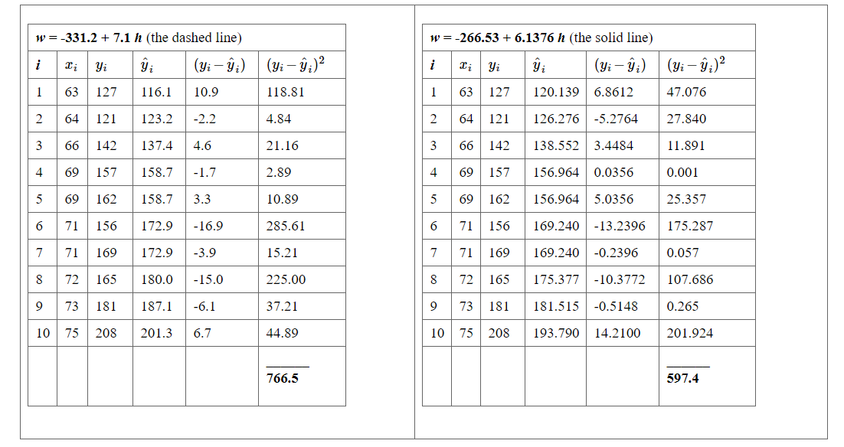
What is the "Best Fitting Line"?

Slide 51
What is the "Best Fitting Line"?
Based on the least squares criterion, which equation best summarizes the data?
The sum of the squared prediction errors is 766.5 for the dashed line, while it is only 597.4 for the solid line.
Therefore, of the two lines, the solid line, w = -266.53 + 6.1376h, best summarizes the data.

Slide 52
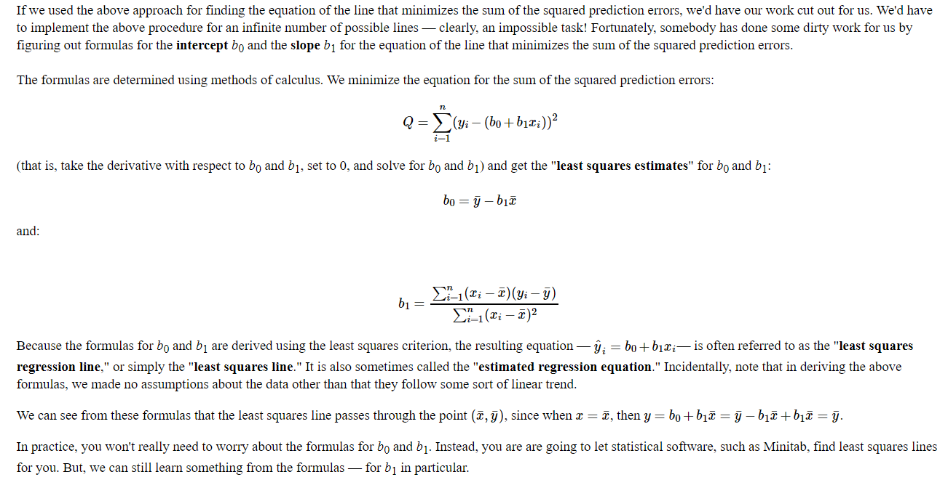
What is the "Best Fitting Line"?

Slide 53
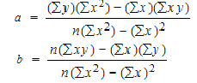
Slope and Intercept calculation

Slide 54
How to Find a Linear Regression Equation: Steps
Step 1: Make a chart of your data, filling in the columns in the same way as you would fill in the chart if you were finding the Pearson’s Correlation Coefficient.
SUBJECT | AGE X | GLUCOSE LEVEL Y | XY | X² | Y²
1 | 43 | 99 | 4257 | 1849 | 9801
2 | 21 | 65 | 1365 | 441 | 4225
3 | 25 | 79 | 1975 | 625 | 6241
4 | 42 | 75 | 3150 | 1764 | 5625
5 | 57 | 87 | 4959 | 3249 | 7569
6 | 59 | 81 | 4779 | 3481 | 6561
Σ | 247 | 486 | 20485 | 11409 | 40022
From the above table, Σx = 247, Σy = 486, Σxy = 20485, Σx2 = 11409, Σy2 = 40022. n is the sample size (6, in our case).

Slide 55
How to Find a Linear Regression Equation: Steps
Step 2: Use the following equations to find a and b.
a = 65.1416 b = .385225

Slide 56
How to Find a Linear Regression Equation: Steps
Step 2: Use the following equations to find a and b.
Find a:
((486 × 11,409) – ((247 × 20,485)) / 6 (11,409) – 247²)
484979 / 7445
=65.14
Find b:
(6(20,485) – (247 × 486)) / (6 (11409) – 247²)
(122,910 – 120,042) / 68,454 – 247²
2,868 / 7,445
= .385225

Slide 57
How to Find a Linear Regression Equation: Steps
Step 3: Insert the values into the equation. y’ = a + bx y’ = 65.14 + .385225x
That’s how to find a linear regression equation by hand!

Slide 58
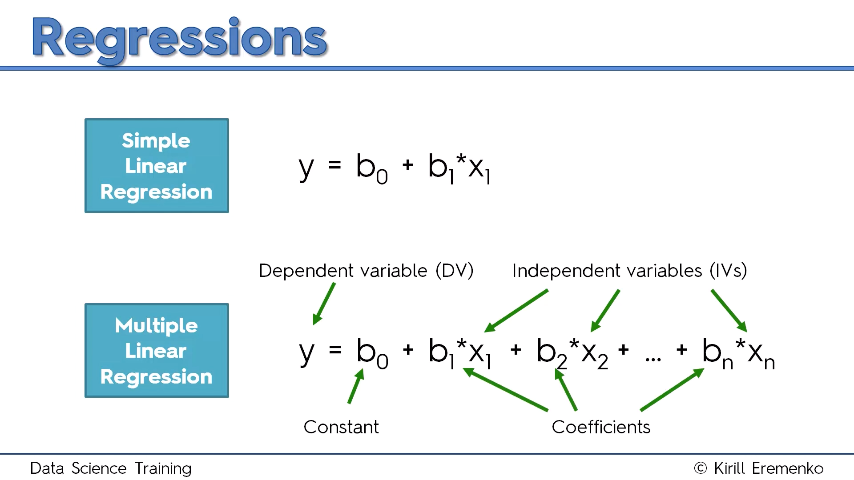
Multiple Linear Regression

Slide 59
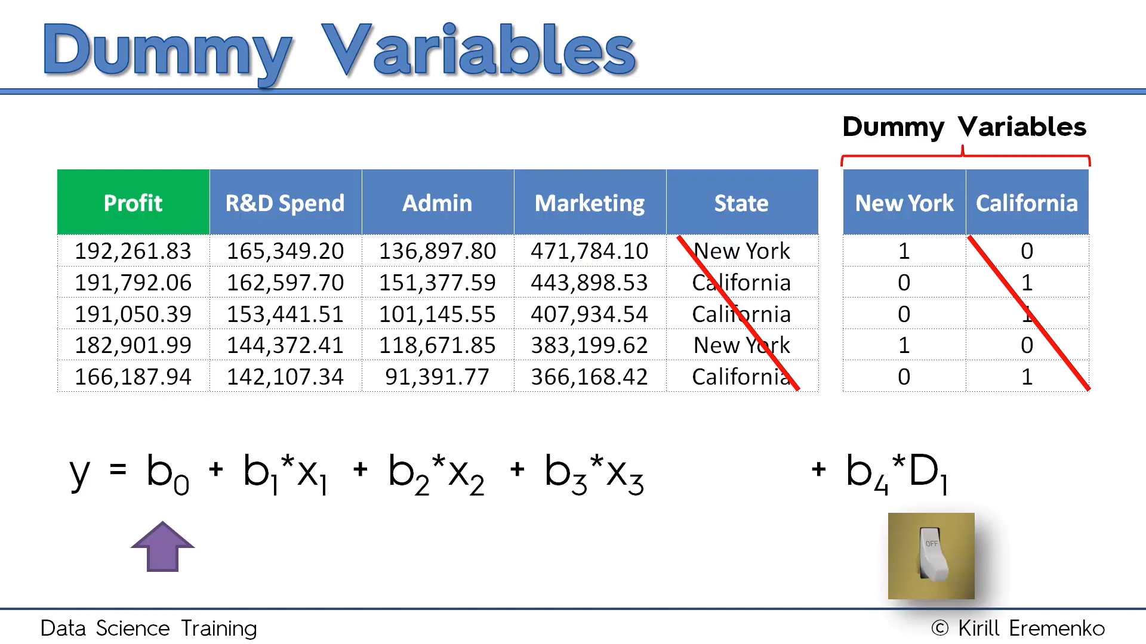

Slide 60
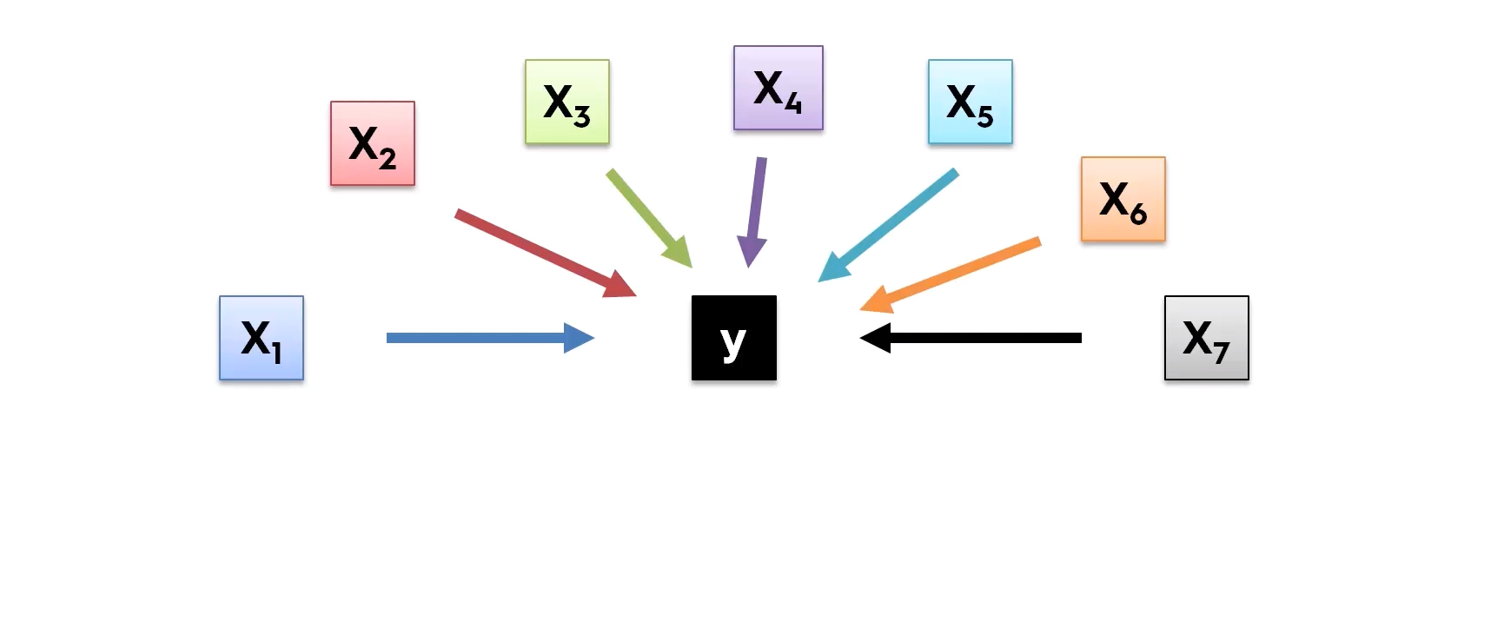
Building Model

Slide 61
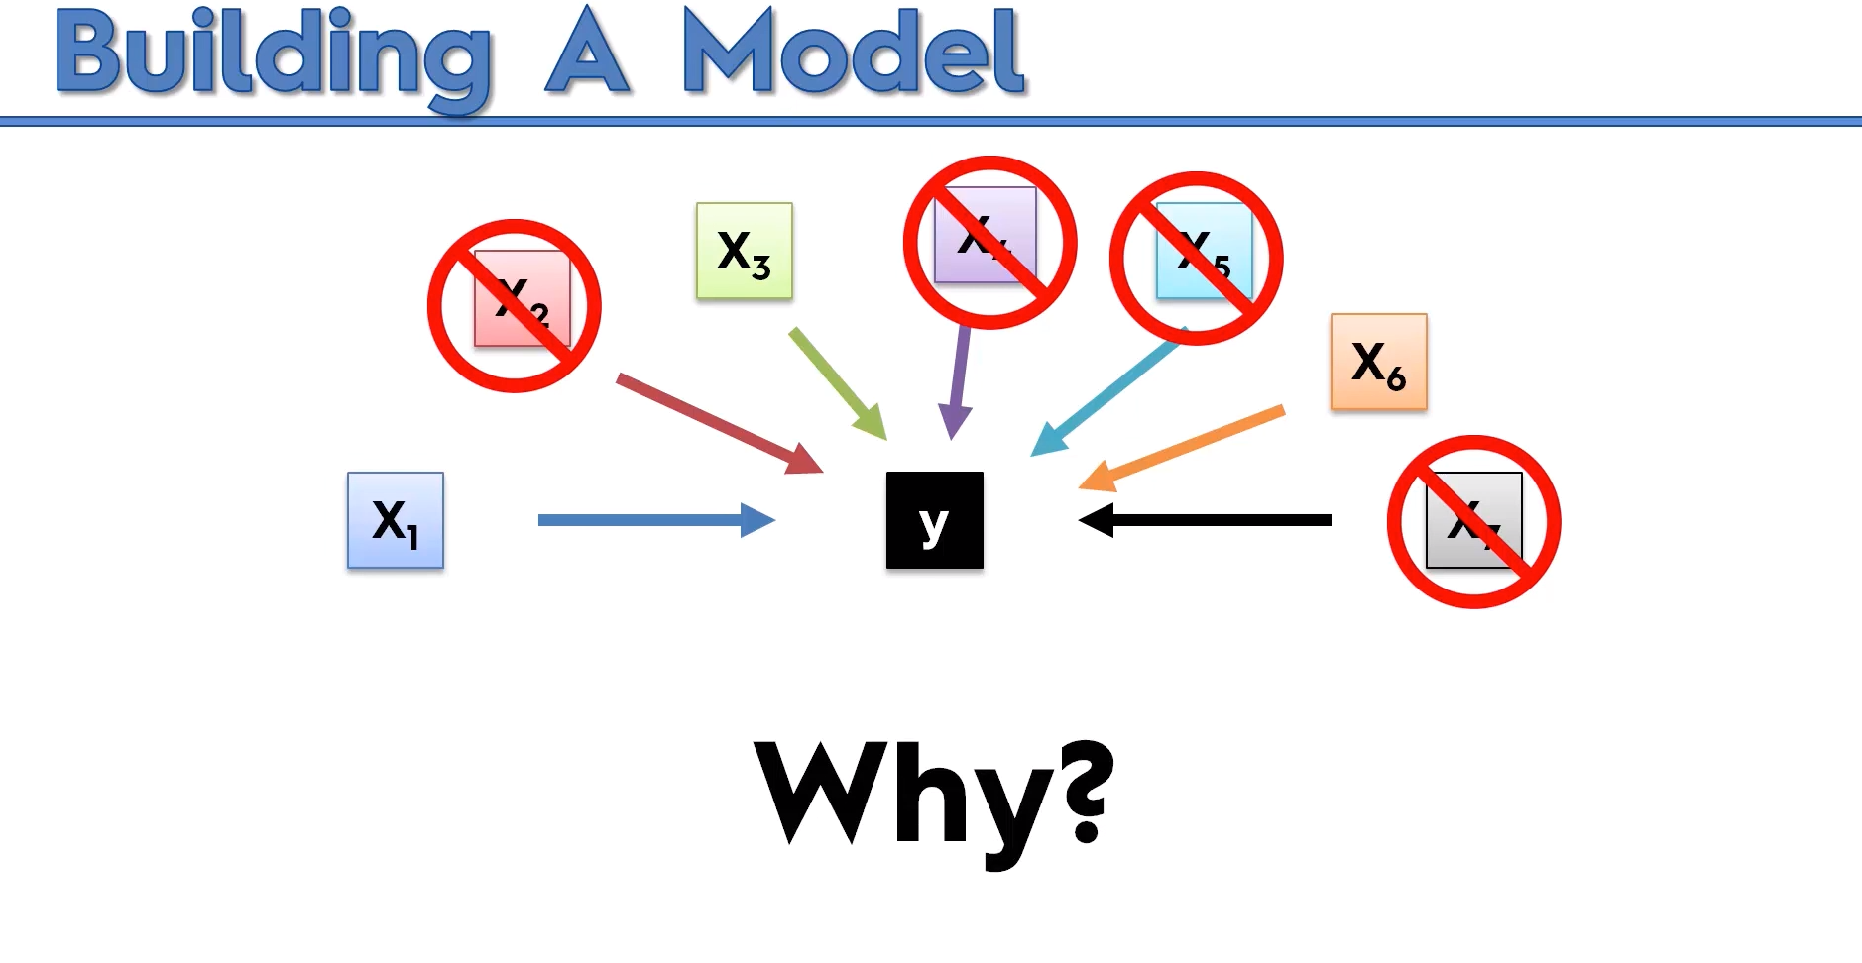

Slide 62
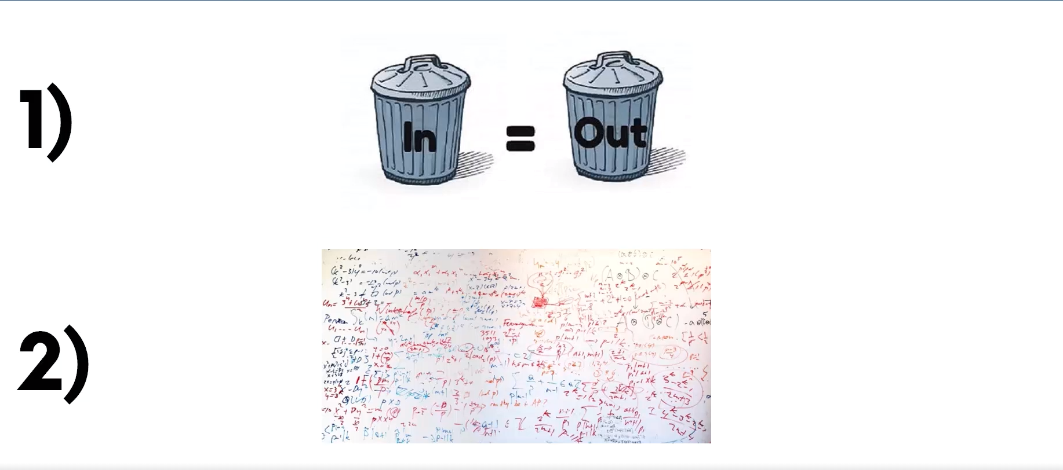

Slide 63
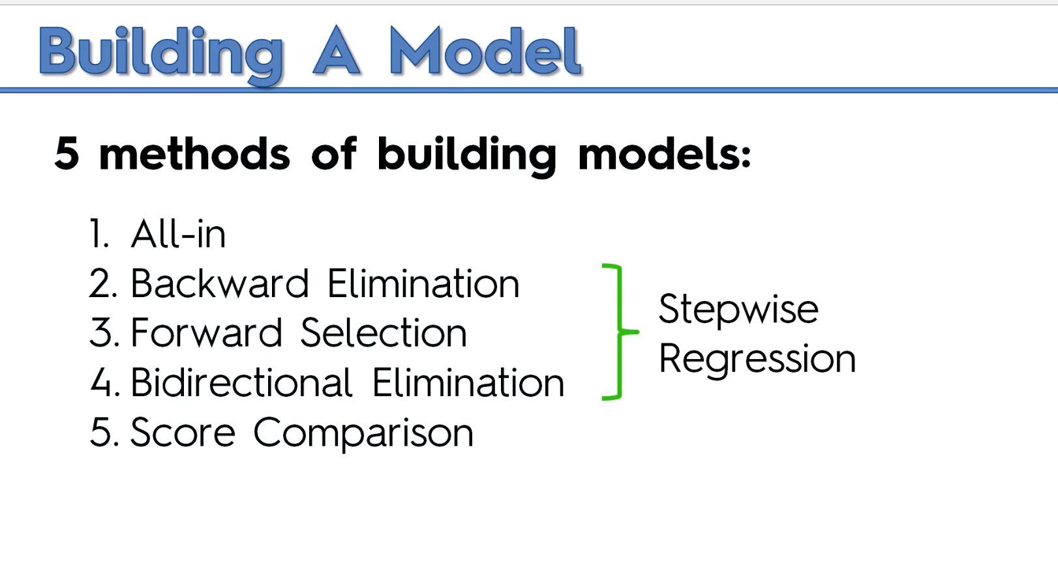

Slide 64
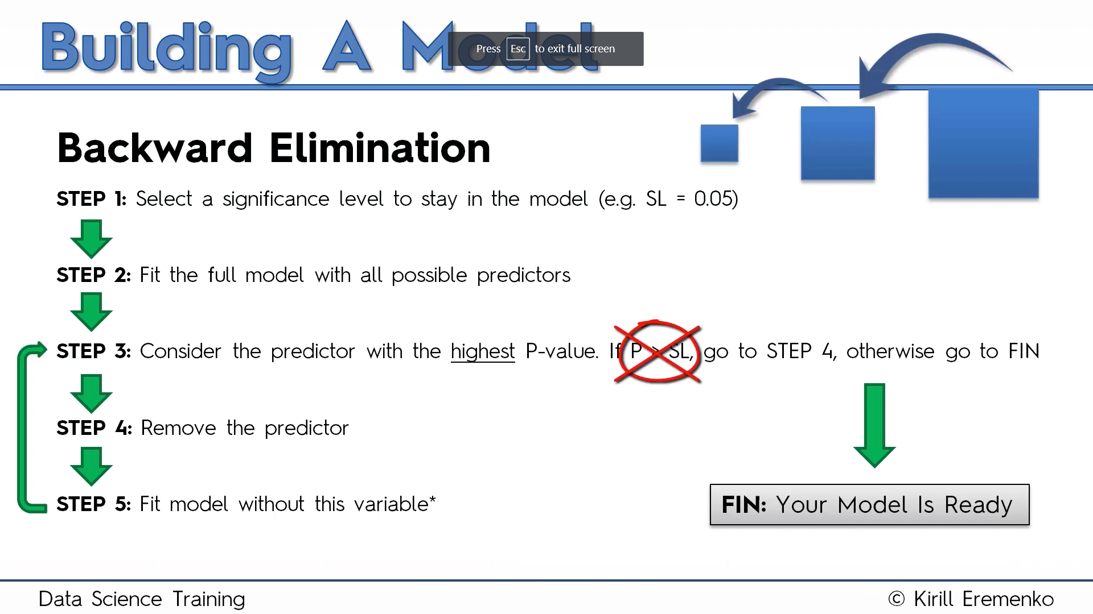

Slide 65
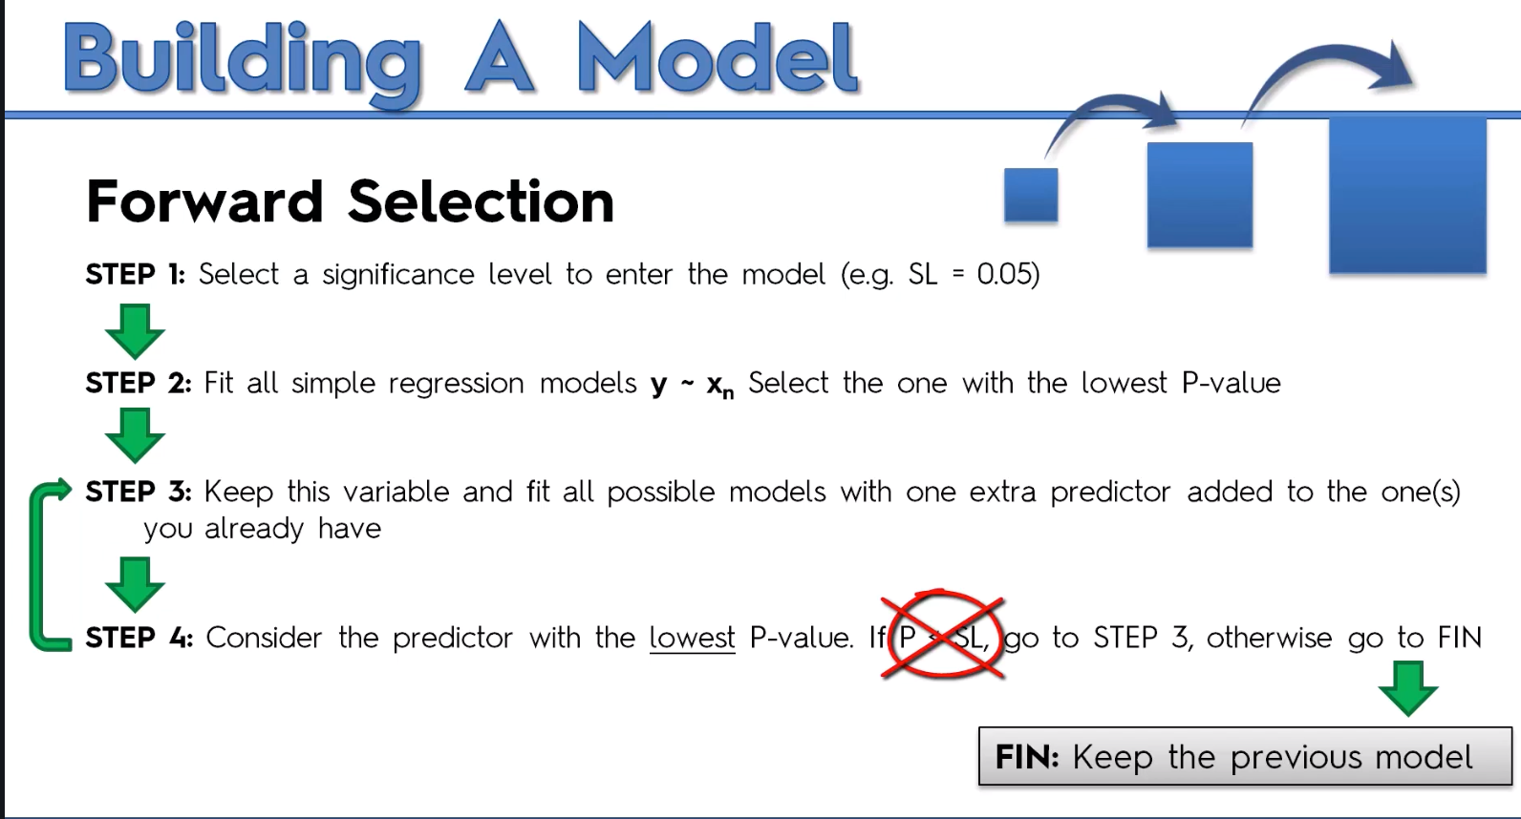

Slide 66
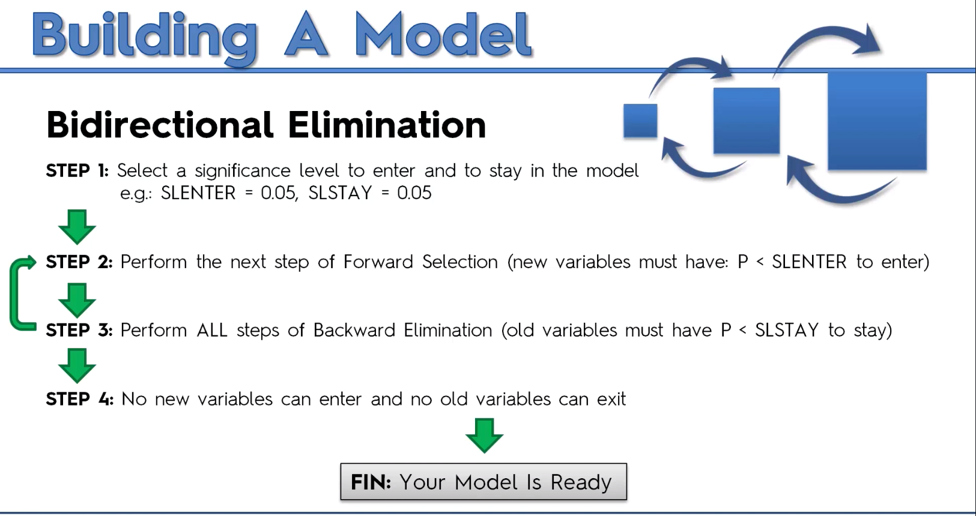

Slide 67
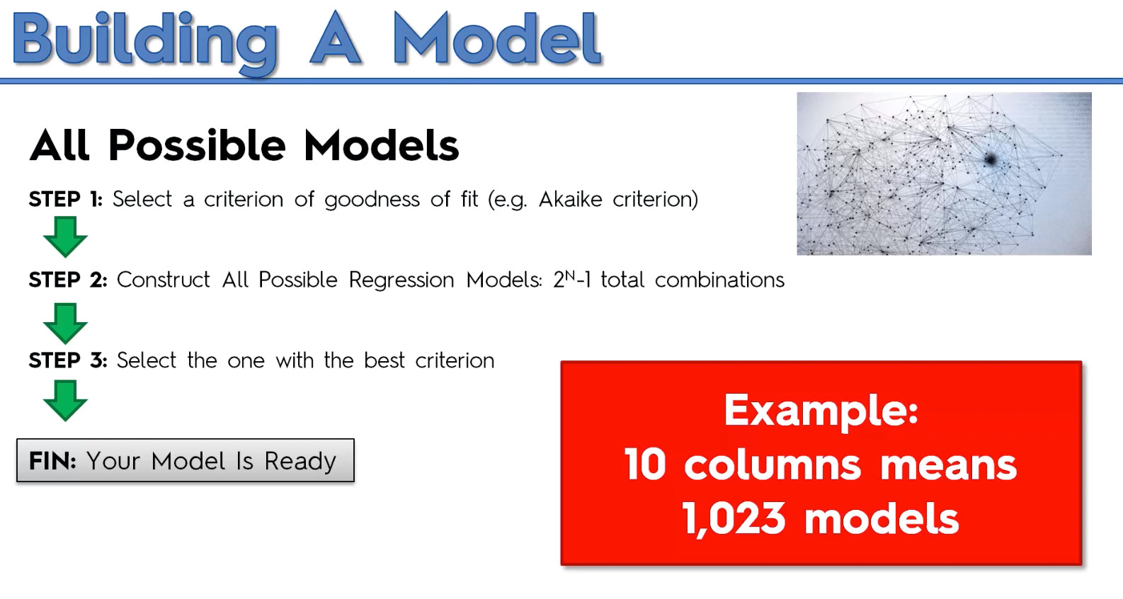

Slide 68
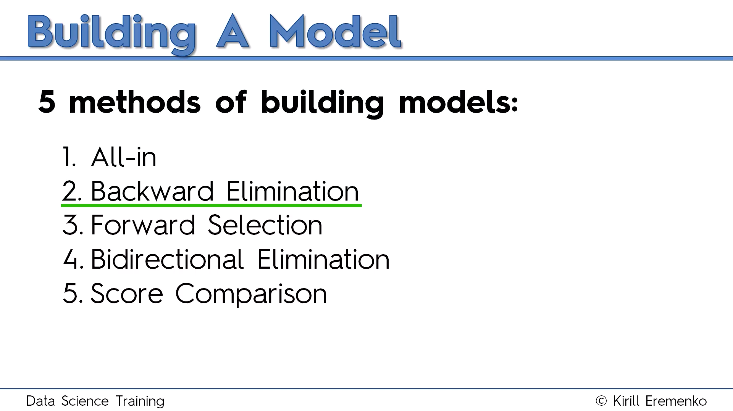

Slide 69
import statsmodels.formula.api as sm
def backwardElimination(x, sl):
numVars = len(x[0])
for i in range(0, numVars):
regressor_OLS = sm.OLS(y, x).fit()
maxVar = max(regressor_OLS.pvalues).astype(float)
if maxVar > sl:
for j in range(0, numVars - i):
if (regressor_OLS.pvalues[j].astype(float) == maxVar):
x = np.delete(x, j, 1)
regressor_OLS.summary()
return x
SL = 0.05
X_opt = X[:, [0, 1, 2, 3, 4, 5]]
X_Modeled = backwardElimination(X_opt, SL)

Slide 70
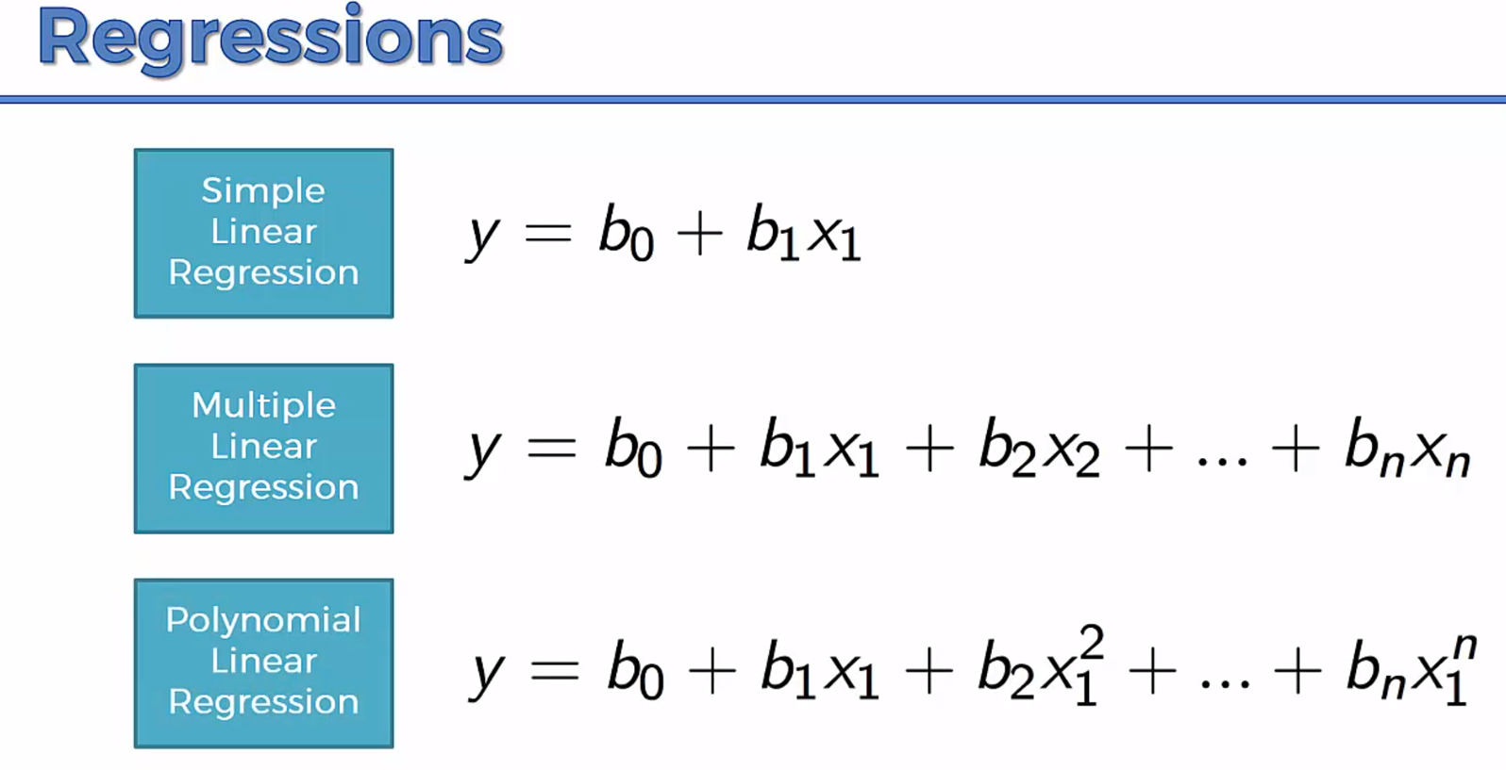

Slide 71


Slide 72
Support Vector Regression
SVM is a supervised learning model
Problem:
I have a business and I receive a lot of emails from customers every day. Some of these emails are complaints and should be answered very quickly. I would like a way to identify them quickly so that I answer these email in priority.

Slide 73
Support Vector Regression
Approach: I can use a supervised machine learning algorithm.
Step 1: I need a lot of emails, the more the better. Step 2: I will read the title of each email and classify it by saying "it is a complaint" or "it is not a complaint". It put a label on each email. Step 3: I will train a model on this dataset Step 4: I will assess the quality of the prediction (using cross validation) Step 5: I will use this model to predict if an email is a complaint or not.
In this case, if I have trained the model with a lot of emails then it will perform well. SVM is just one among many models you can use to learn from this data and make predictions.

Slide 74
Support Vector Regression
SVMs - Support Vector Machines
Wikipedia tells us that SVMs can be used to do two things: classification or regression.
SVM is used for classification
SVR (Support Vector Regression) is used for regression

Slide 75
What is the goal of the Support Vector Machine (SVM)?
The goal of a support vector machine is to find the optimal separating hyperplane which maximizes the margin of the training data.
The first thing we can see from this definition, is that a SVM needs training data. Which means it is a supervised learning algorithm.
It is also important to know that SVM is a classification algorithm. Which means we will use it to predict if something belongs to a particular class.

Slide 76


Slide 77
SVM
We have plotted the size and weight of several people, and there is also a way to distinguish between men and women.
With such data, using a SVM will allow us to answer the following question:
Given a particular data point (weight and size), is the person a man or a woman ?
For instance: if someone measures 175 cm and weights 80 kg, is it a man of a woman?

Slide 78

What is a separating hyperplane?
For instance, we could trace a line and then all the data points representing men will be above the line, and all the data points representing women will be below the line.
Such a line is called a separating hyperplane and is depicted below:

Slide 79
If it is just a line, why do we call it an hyperplane ?
An hyperplane is a generalization of a plane.
in one dimension, an hyperplane is called a point
in two dimensions, it is a line
in three dimensions, it is a plane
in more dimensions you can call it an hyperplane

Slide 80

What is the optimal separating hyperplane?
The fact that you can find a separating hyperplane, does not mean it is the best one !
In the example below there is several separating hyperplanes. Each of them is valid as it successfully separates our data set with men on one side and women on the other side.

Slide 81

Optimal Hyperplane
The black hyperplane classifies more accurately than the green one

Slide 82

What is the margin and how does it help choosing the optimal hyperplane?
Given a particular hyperplane, we can compute the distance between the hyperplane and the closest data point.
Once we have this value, if we double it we will get what is called the margin.
Basically the margin is a no man's land. There will never be any data point inside the margin.

Slide 83
Optimal Hyperplane
We can make the following observations:
If an hyperplane is very close to a data point, its margin will be small.
The further an hyperplane is from a data point, the larger its margin will be.
This means that the optimal hyperplane will be the one with the biggest margin.

Slide 84


What is a vector?
A vector is an object that has both a magnitude and a direction.
If we define a point A(3,4) in R2 we can plot it like this.
Definition: Any point x=(x1,x2),x≠0, in R2 specifies a vector in the plane, namely the vector starting at the origin and ending at x.
If we say that the point at the origin is the point O(0,0) then the vector above is the vector OA→. We could also give it an arbitrary name such as u.

Slide 85


The magnitude
The magnitude or length of a vector x is written ∥x∥ and is called its norm.
For our vector OA→, ∥OA∥ is the length of the segment OA

Slide 86

The direction
The direction is the second component of a vector.
Definition : The direction of a vector u(u1,u2) is the vector w(u1∥u∥,u2∥u∥)

Slide 87


Computing the direction vector
The direction of u(3,4) is the vector w(0.6,0.8)

Slide 88

The sum of two vectors

Slide 89

Third Vector

Slide 90

The difference between two vectors

Slide 91

The difference between two vectors

Slide 92

The dot product
Definition: Geometrically, it is the product of the Euclidian magnitudes of the two vectors and the cosine of the angle between them

Slide 93

We can see that
θ=β−α
So computing cos(θ) is like computing cos(β−α)
There is a special formula called the difference identity for cosine which says that:
cos(β−α)=cos(β)cos(α)+sin(β)sin(α)

Slide 94


Slide 95


Slide 96

The SVM hyperplane
Understanding the equation of the hyperplane
You probably learnt that an equation of a line is : y=ax+b. However when reading about hyperplane, you will often find that the equation of an hyperplane is defined by :

Slide 97
The SVM hyperplane
How does these two forms relate ?
In the hyperplane equation you can see that the name of the variables are in bold. Which means that they are vectors !
Moreover, wTx is how we compute the inner product of two vectors, and if you recall, the inner product is just another name for the dot product !

Slide 98

The SVM hyperplane

Slide 99

The SVM hyperplane
For two reasons:
it is easier to work in more than two dimensions with this notation,
the vector w will always be normal to the hyperplane.

Slide 100
SVM hyperplane
Our goal is to find the distance between the point A(3,4) and the hyperplane.
We start with two vectors, w=(2,1) which is normal to the hyperplane, and a=(3,4) which is the vector between the origin and A.

Slide 101


Slide 102

SVM Hyperplane
Compute the margin of the hyperplane
Now that we have the distance ∥p∥ between A and the hyperplane, the margin is defined by :

Slide 103

Optimal hyperplane

Slide 104
α
Maximum Margin
x
f
y^{est}
Maximizing the margin is good according to intuition and PAC theory
Implies that only support vectors are important; other training examples are ignorable.
Empirically it works very very well.
f(x,w,b) = sign(w x + b)
denotes +1
denotes -1
The maximum margin linear classifier is the linear classifier with the, um, maximum margin.
This is the simplest kind of SVM (Called an LSVM)
Support Vectors are those datapoints that the margin pushes up against
Linear SVM

Slide 105
Linear SVM Mathematically
x⁺
M=Margin Width
“Predict Class = +1” zone
X⁻
wx+b=1
“Predict Class = -1” zone
wx+b=0
wx+b=-1
What we know:
w . x⁺ + b = +1
w . x⁻ + b = -1
w . (x⁺-x⁻⁾ = 2

Slide 106
Linear SVM Mathematically
Goal: 1) Correctly classify all training data
if y_{i} = +1
if y_{i} = -1
for all i
2) Maximize the Margin
same as minimize
We can formulate a Quadratic Optimization Problem and solve for w and b
Minimize
subject to

Slide 107
Solving the Optimization Problem
Find w and b such that
Φ(w) =½ w^{T}w is minimized;
and for all {(x_{i} ,y_{i})}: y_{i} (w^{T}x_{i} + b) ≥ 1
Need to optimize a quadratic function subject to linear constraints.
Quadratic optimization problems are a well-known class of mathematical programming problems, and many (rather intricate) algorithms exist for solving them.
The solution involves constructing a dual problem where a Lagrange multiplier α_{i} is associated with every constraint in the primary problem:
Find α₁…α_{N} such that
Q(α) =Σα_{i} - ½ΣΣα_{i}α_{j}y_{i}y_{j}x_{i}^{T}x_{j} is maximized and
(1) Σα_{i}y_{i} = 0
(2) α_{i} ≥ 0 for all α_{i}

Slide 108
The Optimization Problem Solution
The solution has the form:
Each non-zero α_{i} indicates that corresponding x_{i} is a support vector.
Then the classifying function will have the form:
Notice that it relies on an inner product between the test point x and the support vectors x_{i} – we will return to this later.
Also keep in mind that solving the optimization problem involved computing the inner products x_{i}^{T}x_{j} between all pairs of training points.
w =Σα_{i}y_{i}x_{i} b= y_{k}- w^{T}x_{k} for any x_{k} such that α_{k}≠ 0
f(x) = Σα_{i}y_{i}x_{i}^{T}x + b

Slide 109
Dataset with noise
denotes +1
denotes -1
Hard Margin: So far we require all data points be classified correctly
- No training error
What if the training set is noisy?
- Solution 1: use very powerful kernels
OVERFITTING!

Slide 110
Soft Margin Classification
Slack variables ξi can be added to allow misclassification of difficult or noisy examples.
What should our quadratic optimization criterion be?
Minimize
ε₁₁
ε₂
wx+b=1
ε₇
wx+b=0
wx+b=-1

Slide 111
Hard Margin v.s. Soft Margin
The old formulation:
The new formulation incorporating slack variables:
Parameter C can be viewed as a way to control overfitting.
Find w and b such that
Φ(w) =½ w^{T}w is minimized and for all {(x_{i} ,y_{i})}
y_{i} (w^{T}x_{i} + b) ≥ 1
Find w and b such that
Φ(w) =½ w^{T}w + CΣξ_{i} is minimized and for all {(x_{i} ,y_{i})}
y_{i} (w^{T}x_{i} + b) ≥ 1- ξ_{i} and ξ_{i} ≥ 0 for all i

Slide 112
Linear SVMs: Overview
The classifier is a separating hyperplane.
Most “important” training points are support vectors; they define the hyperplane.
Quadratic optimization algorithms can identify which training points x_{i} are support vectors with non-zero Lagrangian multipliers α_{i}.
Both in the dual formulation of the problem and in the solution training points appear only inside dot products:
Find α₁…α_{N} such that
Q(α) =Σα_{i} - ½ΣΣα_{i}α_{j}y_{i}y_{j}x_{i}^{T}x_{j} is maximized and
(1) Σα_{i}y_{i} = 0
(2) 0 ≤ α_{i} ≤ C for all α_{i}
f(x) = Σα_{i}y_{i}x_{i}^{T}x + b

Slide 113
Non-linear SVMs
Datasets that are linearly separable with some noise work out great:
But what are we going to do if the dataset is just too hard?
How about… mapping data to a higher-dimensional space:
0
x
0
x
x²
0
x

Slide 114
Non-linear SVMs: Feature spaces
General idea: the original input space can always be mapped to some higher-dimensional feature space where the training set is separable:
Φ: x → φ(x)

Slide 115
The “Kernel Trick”
The linear classifier relies on dot product between vectors K(x_{i},x_{j})=x_{i}^{T}x_{j}
If every data point is mapped into high-dimensional space via some transformation Φ: x → φ(x), the dot product becomes:
K(x_{i},x_{j})= φ(x_{i}) ^{T}φ(x_{j})
A kernel function is some function that corresponds to an inner product in some expanded feature space.
Example:
2-dimensional vectors x=[x₁ x₂]; let K(x_{i},x_{j})=(1 + x_{i}^{T}x_{j})²,
Need to show that K(x_{i},x_{j})= φ(x_{i}) ^{T}φ(x_{j}):
K(x_{i},x_{j})=(1 + x_{i}^{T}x_{j})²,
= 1+ x_{i1}²x_{j1}² + 2 x_{i1}x_{j1} x_{i2}x_{j2}+ x_{i2}²x_{j2}² + 2x_{i1}x_{j1} + 2x_{i2}x_{j2}
= [1 x_{i1}² √2 x_{i1}x_{i2} x_{i2}² √2x_{i1} √2x_{i2}]^{T} [1 x_{j1}² √2 x_{j1}x_{j2} x_{j2}² √2x_{j1} √2x_{j2}]
= φ(x_{i}) ^{T}φ(x_{j}), where φ(x) = [1 x₁² √2 x₁x₂ x₂² √2x₁ √2x₂]

Slide 116
What Functions are Kernels?
For some functions K(x_{i},x_{j}) checking that
K(x_{i},x_{j})= φ(x_{i}) ^{T}φ(x_{j}) can be cumbersome.
Mercer’s theorem:
Every semi-positive definite symmetric function is a kernel
Semi-positive definite symmetric functions correspond to a semi-positive definite symmetric Gram matrix:
K(x₁,x₁) | K(x₁,x₂) | K(x₁,x₃) | … | K(x₁,x_{N})
K(x₂,x₁) | K(x₂,x₂) | K(x₂,x₃) |  | K(x₂,x_{N})
… | … | … | … | …
K(x_{N},x₁) | K(x_{N},x₂) | K(x_{N},x₃) | … | K(x_{N},x_{N})
K=

Slide 117
Examples of Kernel Functions
Linear: K(x_{i},x_{j})= x_{i} ^{T}x_{j}
Polynomial of power p: K(x_{i},x_{j})= (1+ x_{i} ^{T}x_{j})^{p}
Gaussian (radial-basis function network):
Sigmoid: K(x_{i},x_{j})= tanh(β₀x_{i} ^{T}x_{j} + β₁)

Slide 118
Non-linear SVMs Mathematically
Dual problem formulation:
The solution is:
Optimization techniques for finding α_{i}’s remain the same!
Find α₁…α_{N} such that
Q(α) =Σα_{i} - ½ΣΣα_{i}α_{j}y_{i}y_{j}K(x_{i}, x_{j}) is maximized and
(1) Σα_{i}y_{i} = 0
(2) α_{i} ≥ 0 for all α_{i}
f(x) = Σα_{i}y_{i}K(x_{i}, x_{j})+ b

Slide 119
Nonlinear SVM - Overview
SVM locates a separating hyperplane in the feature space and classify points in that space
It does not need to represent the space explicitly, simply by defining a kernel function
The kernel function plays the role of the dot product in the feature space.

Slide 120
Properties of SVM
Flexibility in choosing a similarity function
Sparseness of solution when dealing with large data sets
- only support vectors are used to specify the separating hyperplane
Ability to handle large feature spaces
- complexity does not depend on the dimensionality of the feature space
Overfitting can be controlled by soft margin approach
Nice math property: a simple convex optimization problem which is guaranteed to converge to a single global solution
Feature Selection

Slide 121
SVM Applications
SVM has been used successfully in many real-world problems
- text (and hypertext) categorization
- image classification
- bioinformatics (Protein classification,
Cancer classification)
- hand-written character recognition

Slide 122
Application 1: Cancer Classification
High Dimensional
- p>1000; n<100
Imbalanced
- less positive samples
Many irrelevant features
Noisy
Genes
Patients | g-1 | g-2 | …… | g-p
P-1
p-2
…….
p-n
FEATURE SELECTION
In the linear case,
w_{i}² gives the ranking of dim i
SVM is sensitive to noisy (mis-labeled) data ☹

Slide 123
Weakness of SVM
It is sensitive to noise
- A relatively small number of mislabeled examples can dramatically decrease the performance
It only considers two classes
- how to do multi-class classification with SVM?
- Answer:
1) with output arity m, learn m SVM’s
SVM 1 learns “Output==1” vs “Output != 1”
SVM 2 learns “Output==2” vs “Output != 2”
:
SVM m learns “Output==m” vs “Output != m”
2)To predict the output for a new input, just predict with each SVM and find out which one puts the prediction the furthest into the positive region.

Slide 124
Application 2: Text Categorization
Task: The classification of natural text (or hypertext) documents into a fixed number of predefined categories based on their content.
- email filtering, web searching, sorting documents by topic, etc..
A document can be assigned to more than one category, so this can be viewed as a series of binary classification problems, one for each category

Slide 125

Representation of Text
IR’s vector space model (aka bag-of-words representation)
A doc is represented by a vector indexed by a pre-fixed set or dictionary of terms
Values of an entry can be binary or weights
Normalization, stop words, word stems
Doc x => φ(x)

Slide 126
Text Categorization using SVM
The distance between two documents is φ(x)·φ(z)
K(x,z) = 〈φ(x)·φ(z) is a valid kernel, SVM can be used with K(x,z) for discrimination.
Why SVM?
-High dimensional input space
-Few irrelevant features (dense concept)
-Sparse document vectors (sparse instances)
-Text categorization problems are linearly separable

Slide 127
Some Issues
Choice of kernel
- Gaussian or polynomial kernel is default
- if ineffective, more elaborate kernels are needed
- domain experts can give assistance in formulating appropriate similarity measures
Choice of kernel parameters
- e.g. σ in Gaussian kernel
- σ is the distance between closest points with different classifications
- In the absence of reliable criteria, applications rely on the use of a validation set or cross-validation to set such parameters.
Optimization criterion – Hard margin v.s. Soft margin
- a lengthy series of experiments in which various parameters are tested

Slide 128
Decision Tree Regression
Decision tree builds regression or classification models in the form of a tree structure.
It brakes down a dataset into smaller and smaller subsets while at the same time an associated decision tree is incrementally developed.
The final result is a tree with decision nodes and leaf nodes.
A decision node (e.g., Outlook) has two or more branches (e.g., Sunny, Overcast and Rainy), each representing values for the attribute tested.
Leaf node (e.g., Hours Played) represents a decision on the numerical target.
The topmost decision node in a tree which corresponds to the best predictor called root node.
Decision trees can handle both categorical and numerical data.

Slide 129

Decision Tree Regression

Slide 130
Decision Tree Regression
The core algorithm for building decision trees called ID3 by J. R. Quinlan which employs a top-down, greedy search through the space of possible branches with no backtracking.
The ID3 algorithm can be used to construct a decision tree for regression by replacing Information Gain with Standard Deviation Reduction.

Slide 131

Decision Tree Regression

Slide 132

Decision Tree Regression

Slide 133
Decision Tree Regression
1.compute the entropy for data-set
2.for every attribute/feature:
1.calculate entropy for all categorical values
2.take average information entropy for the current attribute
3.calculate gain for the current attribute
3. pick the highest gain attribute.
4. Repeat until we get the tree we desired.

Slide 134

Decision Tree Regression Compute the entropy for the weather data set:

Slide 135

Decision Tree Regression For every feature calculate the entropy and information gain

Slide 136

Pick the highest gain attribute.

Slide 137

So our root node is Outlook.

Slide 138

Repeat the same thing for sub-trees till we get the tree.

Slide 139

Final Decision Tree

Slide 140
Logistic Regression
Logistic regression predicts the probability of an outcome that can only have two values (i.e. a dichotomy).
The prediction is based on the use of one or several predictors (numerical and categorical).
A linear regression is not appropriate for predicting the value of a binary variable for two reasons:
A linear regression will predict values outside the acceptable range (e.g. predicting probabilities outside the range 0 to 1)
Since the dichotomous experiments can only have one of two possible values for each experiment, the residuals will not be normally distributed about the predicted line.

Slide 141
Logistic Regression
On the other hand, a logistic regression produces a logistic curve, which is limited to values between 0 and 1.
Logistic regression is similar to a linear regression, but the curve is constructed using the natural logarithm of the “odds” of the target variable, rather than the probability.
Moreover, the predictors do not have to be normally distributed or have equal variance in each group.

Slide 142
Example
Example 1: Suppose that we are interested in the factors that influence whether a political candidate wins an election.
The outcome (response) variable is binary (0/1); win or lose.
The predictor variables of interest are the amount of money spent on the campaign, the amount of time spent campaigning negatively and whether or not the candidate is an incumbent.
Example 2: A researcher is interested in how variables, such as GRE (Graduate Record Exam scores), GPA (grade point average) and prestige of the undergraduate institution, effect admission into graduate school. The response variable, admit/don’t admit, is a binary variable.

Slide 143

Logistic Regression

Slide 144

Logistic Regression
In the logistic regression the constant (b0) moves the curve left and right and the slope (b1) defines the steepness of the curve. By simple transformation, the logistic regression equation can be written in terms of an odds ratio.

Slide 145

Logistic Regression
Finally, taking the natural log of both sides, we can write the equation in terms of log-odds (logit) which is a linear function of the predictors. The coefficient (b₁) is the amount the logit (log-odds) changes with a one unit change in x.

Slide 146


Logistic Regression
As mentioned before, logistic regression can handle any number of numerical and/or categorical variables.

Slide 147
Natural Language Processing
Natural Language Processing (NLP) refers to AI method of communicating with an intelligent systems using a natural language such as English.
Processing of Natural Language is required when you want an intelligent system like robot to perform as per your instructions, when you want to hear decision from a dialogue based clinical expert system, etc.
The field of NLP involves making computers to perform useful tasks with the natural languages humans use. The input and output of an NLP system can be −
Speech
Written Text

Slide 148
Components of NLP
Natural Language Understanding (NLU)
Understanding involves the following tasks −
Mapping the given input in natural language into useful representations.
Analyzing different aspects of the language.
Natural Language Generation (NLG)
It is the process of producing meaningful phrases and sentences in the form of natural language from some internal representation.

Slide 149
Components of NLP
It involves −
Text planning − It includes retrieving the relevant content from knowledge base.
Sentence planning − It includes choosing required words, forming meaningful phrases, setting tone of the sentence.
Text Realization − It is mapping sentence plan into sentence structure.

Slide 150
Difficulties in NLU
Lexical ambiguity − It is at very primitive level such as word-level.
For example, treating the word “board” as noun or verb?
Syntax Level ambiguity − A sentence can be parsed in different ways.
For example, “He lifted the beetle with red cap.” − Did he use cap to lift the beetle or he lifted a beetle that had red cap?
Referential ambiguity − Referring to something using pronouns. For example, Rima went to Gauri. She said, “I am tired.” − Exactly who is tired?

Slide 151

Steps in NLP

Slide 152
Where Can Developers Use NLP Algorithms For?
Summarize blocks of text (Summarizer tool)
https://algorithmia.com/
Create a chat bot
Parsey McParseface --- Parse sentences with ease.
Automatically generate keyword tags
Identify the type of entity extracted,
Use Sentiment Analysis to identify the sentiment of a string of text,
Reduce words to their root, or stem, using PorterStemmer, or break up text into tokens using Tokenizer.

Slide 153
Artificial Neural Network
Neural Networks are a machine learning framework that attempts to mimic the learning pattern of natural biological neural networks.
Biological neural networks have interconnected neurons with dendrites that receive inputs, then based on these inputs they produce an output signal through an axon to another neuron.
We will try to mimic this process through the use of Artificial Neural Networks (ANN), which we will just refer to as neural networks from now on.
The process of creating a neural network begins with the most basic form, a single perceptron.

Slide 154

Single Layer Network

Slide 155
Artificial Neural Network
Perceptron as AND Gate
A perceptron can be used as a separator or a decision line that divides the input set of AND Gate, into two classes:
Class 1: Inputs having output as 0 that lies below the decision line.
Class 2: Inputs having output as 1 that lies above the decision line or separator.

Slide 156

Artificial Neural Network
The below diagram shows the above idea of classifying the inputs of AND Gate using a perceptron:

Slide 157

Artificial Neural Network
Mathematically, one can represent a perceptron as a function of weights, inputs and bias (vertical offset):

Slide 158
Artificial Neural Network
Each of the input received by the perceptron has been weighted based on the amount of its contribution for obtaining the final output.
Bias allows us to shift the decision line so that it can best separate the inputs into two classes.

Slide 159

Activation Function
The input received by a perceptron is first multiplied by the respective weights and then, all these weighted inputs are summed together.
This summed value is then fed to activation for obtaining the final result as shown in the image below followed by the the code:

Slide 160
Activation Function
input x | network fires or not (y) | told correct answer (O) | what to do with w's | what to do with t
(0,1,0,0) | 0 | 1 | increase | reduce
(1,0,0,0) | 0 | 0 | no change | no change
(0,1,1,1) | 1 | 0 | reduce | increase
(1,0,1,0) | 1 | 0 | reduce | increase
(1,1,1,1) | 0 | 1 | increase | reduce
(0,1,0,0) | 1 | 1 | no change | no change
.... | .... | .... | .... | ....
The sequence of exemplars presented may go like this:

Slide 161
Limitations of Single-Layer Perceptron:
Well, there are two major problems:
Single-Layer Percpetrons cannot classify non-linearly separable data points.
Complex problems, that involve a lot of parameters cannot be solved by Single-Layer Perceptrons.

Slide 162
Complex problems, that involve a lot of parameters cannot be solved by Single-Layer Perceptrons:
The marketing team can market your product through various ways, such as:
Google Ads
Personal emails
Sale advertisement on relevant sites
Reference program
Blogs and so on . . .
Considering all the factors and options available, marketing team has to decide a strategy to do optimal and efficient marketing, but this task is too complex for a human to analyse, because number of parameters are quite high.
This problem will have to be solved using Deep Learning.

Slide 163

Complex problems, that involve a lot of parameters cannot be solved by Single-Layer Perceptrons:

Slide 164

Complex problems, that involve a lot of parameters cannot be solved by Single-Layer Perceptrons:

Slide 165

Complex problems, that involve a lot of parameters cannot be solved by Single-Layer Perceptrons:

Slide 166

What is Multi-Layer Perceptron?

Slide 167
What is Multi-Layer Perceptron?
Input Nodes – The Input nodes provide information from the outside world to the network and are together referred to as the “Input Layer”. No computation is performed in any of the Input nodes – they just pass on the information to the hidden nodes.
Hidden Nodes – The Hidden nodes have no direct connection with the outside world (hence the name “hidden”). They perform computations and transfer information from the input nodes to the output nodes. A collection of hidden nodes forms a “Hidden Layer”. While a network will only have a single input layer and a single output layer, it can have zero or multiple Hidden Layers. A Multi-Layer Perceptron has one or more hidden layers.
Output Nodes – The Output nodes are collectively referred to as the “Output Layer” and are responsible for computations and transferring information from the network to the outside world.

Slide 168
What is Multi-Layer Perceptron?
Goal Lead in First Half | Possession in Second Half | Won or Lost (1,0)?
0 | 80% | 1
0 | 35% | 0
1 | 42% | 1
2 | 20% | 0
-1 | 75% | 1
Suppose we have data of a football team, Chelsea. The data contains three columns. The last column tells whether Chelsea won the match or they lost it. The other two columns are about, goal lead in the first half and possession in the second half. Possession is the amount of time for which the team has the ball in percentage. So, if I say that a team has 50% possession in one half (45 minutes), it means that, the team had ball for 22.5 minutes out of 45 minutes.

Slide 169
What is Multi-Layer Perceptron?
Now, suppose, we want to predict whether Chelsea will win the match or not, if the goal lead in the first half is 2 and the possession in the second half is 32%.
This is a binary classification problem where a multi layer Perceptron can learn from the given examples (training data) and make an informed prediction given a new data point.
The process by which a Multi Layer Perceptron learns is called the Backpropagation algorithm.

Slide 170
Backpropagation:
Backpropagation is a supervised learning algorithm, for training Multi-layer Perceptrons (Artificial Neural Networks).
Why We Need Backpropagation?
While designing a Neural Network, in the beginning, we initialize weights with some random values or any variable for that fact.
Now obviously, we are not superhuman. So, it’s not necessary that whatever weight values we have selected will be correct, or it fits our model the best.
Okay, fine, we have selected some weight values in the beginning, but our model output is way different than our actual output i.e. the error value is huge.
Now, how will you reduce the error?
Basically, what we need to do, we need to somehow explain the model to change the parameters (weights), such that error becomes minimum.

Slide 171

Backpropagation:

Slide 172
Backpropagation:
Let me summarize the steps for you:
Calculate the error – How far is your model output from the actual output.
Error minimum? – Check whether the error is minimized or not.
Update the parameters – If the error is huge then, update the parameters (weights and biases). After that again check the error. Repeat the process until the error becomes minimum.
Model is ready to make a prediction – Once the error becomes minimum, you can feed some inputs to your model and it will produce the output.

Slide 173
Backpropagation Algorithm
initialize network weights (often small random values)
do
forEach training example named ex
prediction = neural-net-output(network, ex) // forward pass
actual = teacher-output(ex)
compute error (prediction - actual) at the output units
compute {\displaystyle \Delta w_{h}} for all weights from hidden layer to output layer // backward pass
compute {\displaystyle \Delta w_{i}} for all weights from input layer to hidden layer // backward pass continued
update network weights // input layer not modified by error estimate
until all examples classified correctly or another stopping criterion satisfied
return the network

Slide 174

How Backpropagation Works?

Slide 175

Step – 1: Forward Propagation

Slide 176

We will repeat this process for the output layer neurons, using the output from the hidden layer neurons as inputs.

Slide 177

Now, let’s see what is the value of the error:

Slide 178

Step – 2: Backward Propagation

Slide 179


Since we are propagating backwards, first thing we need to do is, calculate the change in total errors w.r.t the output O1 and O2.

Slide 180

Let’s see now how much does the total net input of O1 changes w.r.t W5?

Slide 181

Step – 3: Putting all the values together and calculating the updated weight value

Slide 182
How does a machine look at an image?
In simple terms, every image is an arrangement of dots (a pixel) arranged in a special order. If you change the order or color of a pixel, the image would change as well.
The machine will basically break this image into a matrix of pixels and store the color code for each pixel at the representative location.
In the representation below – number 1 is white and 256 is the darkest shade of green color (I have constrained the example to have only one color for simplicity).

Slide 183

How does a machine look at an image?

Slide 184
How do we help a neural network to identify images ?
Flattened Array

Slide 185
Convolutional Neural Networks
CNNs, like neural networks, are made up of neurons with learnable weights and biases.
Each neuron receives several inputs, takes a weighted sum over them, pass it through an activation function and responds with an output.
The whole network has a loss function and all the tips and tricks that we developed for neural networks still apply on CNNs.

Slide 186
Defining a Convolutional Neural Network
We need three basic components to define a basic convolutional network.
The convolutional layer
The Pooling layer[optional]
The output layer

Slide 187


The Convolution Layer
Suppose we have an image of size 6*6. We define a weight matrix which extracts certain features from the images

Slide 188

The Convolution Layer
Suppose we have an image of size 6*6. We define a weight matrix which extracts certain features from the images

Slide 189

How are Convolutional Neural Networks different than Neural Networks?
CNNs operate over Volumes !
Unlike neural networks, where the input is a vector, here the input is a multi-channeled image (3 channeled in this case).

Slide 190


Convolution
Convolution is a mathematical way of combining two signals to form a third signal.
It is the single most important technique in Digital Signal Processing.
Using the strategy of impulse decomposition, systems are described by a signal called the impulse response.
Convolution is important because it relates the three signals of interest: the input signal, the output signal, and the impulse response.

Slide 191


Slide 192


Slide 193


Slide 194


Slide 195

Pooling Layers

Slide 196

Putting it all together – How does the entire network look like ?

Slide 197

Typical Architecture of a CNN

Slide 198
Reinforcement Learning
Reinforcement Learning focusses on getting machines and software agents to automatically determine the best behaviour within a specific context, in order to maximize performance.
When the machine takes an action that increases the performance it gets an simple reward feedback, this is known as the reinforcement signal hence the name reinforcement learning.
In other words, the machine is learning a behaviour based on feedback from the environment, this process can be done once and for all or keep on improving preformance as time goes by.

Slide 199
Armed Bandit problem
A single armed Bandit process is a machine that is characterized by random sequences, and can be found in different states where some states deliver reward and others a penalty.
In our example the slot machine changes to different states when engaged and results in a return on investment when we win and no return when we lose.

Slide 200
Multi Armed Bandit problem
The multi armed Bandit problem is a collection of K single armed Bandit processes and one controller.
The controller can choose to operate only one machine at a time, the other machines remain unchanged.
We assume that every machine has a different probability distribution on giving an reward to the controller, in other words each machine has a fixed probability of winning and losing.
Our goal is to find the machine with the highest probability of winning, machine with the highest average return.
The problem lies in the fact that we do not know which machine has the highest average return, nor can we distriminate between the machines because they look the same.
We need a strategy that in each round tells me which machine to try next.

Slide 201
The Upper Confidence Bound Algorithm
The Upper Confidence Bound Algorithm is a Reinforcement Learning Algorithm that learns an optimal behavior by minimizing regret, following an optimistic stategy, exploring/exploiting and confidence intervals.
Minimizing regret means to minimize the cost of not knowing which of the K machines is optimal, an optimal machine having the highest average return.
Regret at a given round t (pink formula) is calculated with the mean distribution of the optimal machine minus that of the current machine.
The total regret (RT) being the sum of regrets.
RT divided by T(total rounds) should be approaching zero when T approaches infinite, ensuring that RT/T --> 0 is stronger than maximizing rewards, since in the limit we discover the true optimal machine.

Slide 202

The Upper Confidence Bound Algorithm

Slide 203
UCB
The UCB follows a optimistic strategy because the algorithm believes it can obtain extra rewards by reaching the unexplored parts of the state space.
n other words, the UCB will continue exploring other behaviours (or machines) until the true optimal behaviour or sequence of behaviours is found.
Exploring is about gathering information about the the returns of the K machines while exploitation is about making decisions based on data already gathered.
There will be a trade off between exploring and exploiting, in the case of the UCB it will keep op exploring until true optimal is found.

Slide 204
UCB
The UCB algorithm decides which machine to exploit or if it should explore another option using confidence intervals, more specific the highest upper confidence bound.
A confidence interval is a range of values within which we are sure the mean lies with a certain probability.
The less we try a machine the less accurate our estimated average return for that machine and so the confidence interval is large.
Every round we try machine we gather more information and the confidence interval shrinks, narrowing in on the true mean of the slot machine.
To make it more clear how confidence bounds works let's assume that the mean of the slot machine blue is in within [0.2, 0,9] with probability 0.95

Slide 205


UCB
After a few rounds trying the blue slot machine, since it has the highest upper bounds, the confidence bound has shrink to [0.4, 0.7].
During the exploring/exploiting process UBC also tries the red slot machine, since it had at times the highest upper bound and actually is the machine with the highest average return.

Slide 206
Reinforcement Learning
Reinforcement Learning is learning what to do and how to map situations to actions.
The end result is to maximize the numerical reward signal.
The learner is not told which action to take, but instead must discover which action will yield the maximum reward.
Let’s understand this with a simple example below.

Slide 207

Reinforcement Learning

Slide 208


Reinforcement Learning

Slide 209

Slot Machines
Now you want to do is get the maximum bonus from the slot machines as fast as possible. What would you do?

Slide 210

An implementation of Reinforcement Learning

Slide 217
Multi-Armed Bandit (MAB) Problem
N arms
Assume
Statistical feedback
Assume
rewards in [0,1]
…
Observes Loss/Reward For The Chosen Arm
ML Algorithm
Suffers Loss/Reward
Pulls Arm

Slide 218
Regret in the MAB Setting
Since we are stochastic, each arm has a true mean
Do as well as if pulled always pulled arm with highest mean

Slide 219
MABs have a huge number of applications!
Internet Advertising
Website Layout
Clinical Trials
Robotics
Education
Videogames
Recommender Systems
…
Unlike most of Machine Learning, how to ACT,
not just how to predict!

Slide 220

MAB algorithm #1: ε-first
Phase 1: Explore arms uniformly at random
Phase 2: Exploit best arm so far
Only 1 parameter: how long to wait!
Problem?
Not very efficient
Makes statistics easy to run

Slide 221
MAB algorithm #2: ε-greedy
Flip a coin:
With probability ε, explore uniformly
With probability 1- ε, exploit
Only 1 parameter: ε
Problem?
Often used in robotics and reinforcement learning

Slide 222

Upper Confidence Bound (UCB)
1. Play each arm once
2. Play arm i that maximizes:
$${\hat{μ}}_{i}+\sqrt{\frac{2log⁡(t)}{n_{i}}}$$
3. Repeat Step 2 forever

Slide 223


UCB Regret Bound
Problem –independent:
$$O(\sqrt{NTlogT})$$
Problem –dependent:
$$O\left(\frac{\log{T}}{\min_{i}{μ^{∗}−μ_{i}}}\right)$$
Can’t do much better!

Slide 228
Thompson Sampling
Like the UCB the Thompson Sampling Algorithm deals with the exploration-exploitation dilemma in the multi-armed bandit problem.
However it does this in a different manner.
In contrast to the UCB, which is a deterministic algorithm, Thompson Sampling is a probablistic algorithm making decisions based on random sampling of prior distributions, whereas the UCB does this strictly with the confidence bounds.

Slide 229
Thompson Sampling
The TS takes n samples of each of the K armed bandits and creates K distributions based on these samples.
These initial distributions are not the true distributions of the K bandits, so we call them prior distributions.
Like the UCB we want to find the bandit with the highest mean, to refer the same example; to find the slot machine with the highest average return.
The TS takes one value from each K prior distributions and uses these values as the prior mean of each of the K bandits.
The TS will exploit the bandit with the highest prior mean and uses the recieved reward to improve the prior distribution it has for this bandit, this process repeats until the optimal bandit is found.

Slide 230
Thompson Sampling
In other words, the TS algorithm creates a hypothetical set up of the bandits and randomly samples every round their prior means, the bandit with the highest prior mean will be exploited and thus resulting in more information about the true mean of this bandit.
After plenty of rounds the prior distributions will start resembling the true distributions and thus revealing the optimal bandit.

Slide 231

Thompson Sampling

Slide 237
Association Rule Learning in R
When we go grocery shopping, we often have a standard list of things to buy. Each shopper has a distinctive list, depending on one’s needs and preferences.
A housewife might buy healthy ingredients for a family dinner, while a bachelor might buy coffee and chips.
Understanding these buying patterns can help to increase sales in several ways. If there is a pair of items, X and Y, that are frequently bought together:

Slide 238
Association Rule Learning in R
Both X and Y can be placed on the same shelf, so that buyers of one item would be prompted to buy the other.
Promotional discounts could be applied to just one out of the two items.
Advertisements on X could be targeted at buyers who purchase Y.
X and Y could be combined into a new product, such as having Y in flavors of X.

Slide 239


Association Rule Learning in R
Measure 1: Support. This says how popular an itemset is, as measured by the proportion of transactions in which an itemset appears. In Table 1 below, the support of {apple} is 4 out of 8, or 50%. Itemsets can also contain multiple items. For instance, the support of {apple, beer, rice} is 2 out of 8, or 25%.

Slide 240
Association Rule Learning in R
If you discover that sales of items beyond a certain proportion tend to have a significant impact on your profits, you might consider using that proportion as your support threshold.
You may then identify item sets with support values above this threshold as significant item sets.

Slide 241

Association Rule Learning in R
Measure 2: Confidence. This says how likely item Y is purchased when item X is purchased, expressed as {X -> Y}. This is measured by the proportion of transactions with item X, in which item Y also appears. In Table 1, the confidence of {apple -> beer} is 3 out of 4, or 75%.

Slide 242

Association Rule Learning in R
Measure 3: Lift. This says how likely item Y is purchased when item X is purchased, while controlling for how popular item Y is. In Table 1, the lift of {apple -> beer} is 1,which implies no association between items. A lift value greater than 1 means that item Y is likely to be bought if item X is bought, while a value less than 1 means that item Y is unlikely to be bought if item X is bought.

Slide 243

Associations between selected items. Visualized using the arulesViz R library.

Slide 244



Slide 245
Apriori Algorithm
The apriori principle can reduce the number of itemsets we need to examine. Put simply, the apriori principle states that if an itemset is infrequent, then all its subsets must also be infrequent.
This means that if {beer} was found to be infrequent, we can expect {beer, pizza} to be equally or even more infrequent. So in consolidating the list of popular itemsets, we need not consider {beer, pizza}, nor any other itemset configuration that contains beer.

Slide 246
Finding itemsets with high support
Using the apriori principle, the number of itemsets that have to be examined can be pruned, and the list of popular itemsets can be obtained in these steps:
Step 0. Start with itemsets containing just a single item, such as {apple} and {pear}.
Step 1. Determine the support for itemsets. Keep the itemsets that meet your minimum support threshold, and remove itemsets that do not.
Step 2. Using the itemsets you have kept from Step 1, generate all the possible itemset configurations.
Step 3. Repeat Steps 1 & 2 until there are no more new itemsets.

Slide 247
Limitations
Computationally Expensive. Even though the apriori algorithm reduces the number of candidate itemsets to consider, this number could still be huge when store inventories are large or when the support threshold is low. However, an alternative solution would be to reduce the number of comparisons by using advanced data structures, such as hash tables, to sort candidate itemsets more efficiently.
Spurious Associations. Analysis of large inventories would involve more itemset configurations, and the support threshold might have to be lowered to detect certain associations. However, lowering the support threshold might also increase the number of spurious associations detected. To ensure that identified associations are generalizable, they could first be distilled from a training dataset, before having their support and confidence assessed in a separate test dataset.

